Slide 1
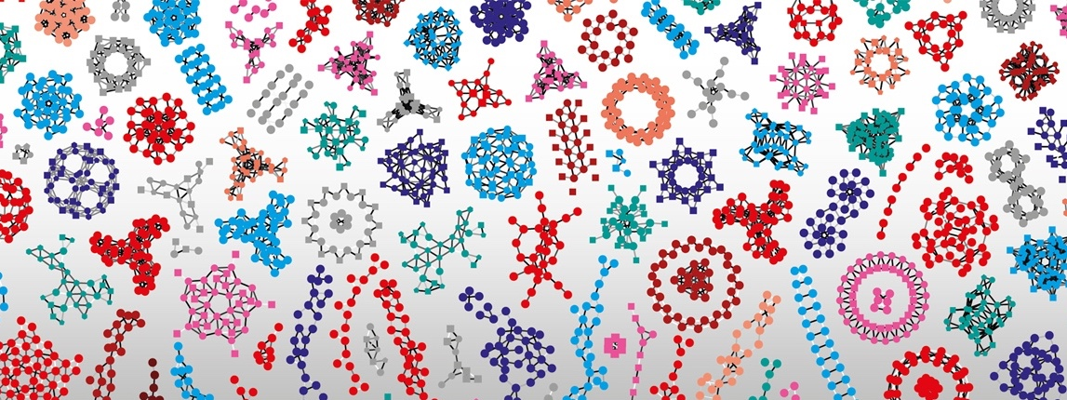

SIB Swiss Institute of Bioinformatics
Introduction to Machine Learning with Python, 03 - 04 October 2022
Wandrille Duchemin and Markus Müller

Slide 2
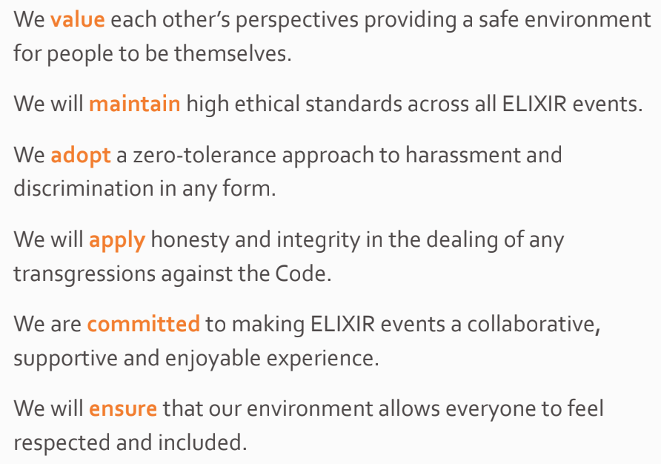

Code of conduct
SIB abides by the ELIXIR Code of Conduct. We are all thus expected to abide by the same code. In summary:
https://elixir-europe.org/events/code-of-conduct
Notes:
And you will find the full code in the given URL

Slide 3




A quick round of introduction
Wandrille Duchemin
Bioinformatics Support and Training
SIB Swiss Institute of Bioinformatics / sciCORE UNIBAS
Markus Mueller
Principal Computational Biologist
Vital-IT, SIB Swiss Institute of Bioinformatics
Fritz Bayer
Computational Biology Group , SIB Swiss Institute of Bioinformatics
Monique Zahn
Training Manager and neXtProt Quality Manager
SIB Swiss Institute of Bioinformatics

Slide 4
Course agenda
09:00 - 09:30 | Day 1: Course Introduction
09:30 - 10:00 | Introduction to Machine Learning (theory) (Wandrille)
10:00 - 10:30 | Exploratory Analysis and Unsupervised Learning (theory) - Data preparation for ML (Markus) - Dimensionality reduction/Embedding (Markus)
10:30 - 11:00 | Coffee Break
11:00 - 12:00 | Exploratory Analysis and Unsupervised Learning (practical) (Markus)
12:00 - 12:30 | Exploratory Analysis and Unsupervised Learning (theory) - Clustering methods (Wandrille)
12:30 - 13:30 | Lunch break
13:30 - 14:00 | Exploratory Analysis and Unsupervised Learning (practical) (Markus)
14:00 - 14:30 | Supervised Learning (theory) - Introduction (Wandrille) - Performance metrics (Wandrille) K-nearest neighbors (Markus) - Logistic regression (Markus) - Support vector machines (Markus)
14:30 - 15:00 | Coffee Break
15:00 - 17:00 | Supervised Learning (practical) (Markus)
09:00 - 09:30 | Welcome Day 2 - Questions from Day 1 - Agenda
09:30 - 10:30 | Supervised Learning (practical) (Markus)
10:30 - 11:00 | Coffee Break
11:00 - 11:30 | Supervised Learning (theory) - Decision trees (Wandrille) - Random Forests (Wandrille) - Ada Boost (Wandrille) - Gradient boosting (Wandrille)
11:30 - 12:30 | Regression(theory) (Markus)
12:30 - 13:30 | Lunch break
13:30 - 14:30 | Regression (parctical) - Linear regression (Markus) - KNN regression (Markus) - Support vector regression (Markus) - Gradient boosting regression (Markus)
14:30 - 15:00 | Coffee Break
15:00 - 16:30 | Supervised Learning (practical) (Wandrille) - Deep learning (Wandrille) - Neural networks (Wandrille)
16:30 - 17:00 | Closing questions, Discussion
Isabelle Dupanloup, BCF

Slide 5
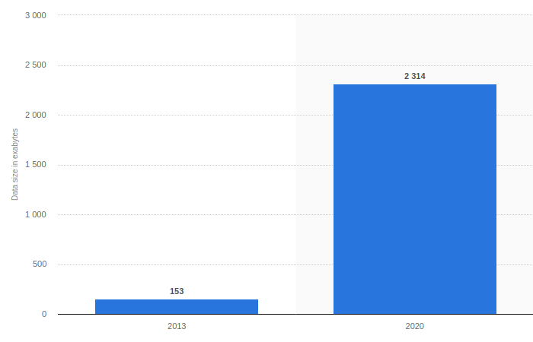
Total amount of global healthcare data generated and projections for end 2020 (in exabytes)
1 exabyte = 1 billion gigabytes
https://www.statista.com/statistics/1037970/global-healthcare-data-volume/
Isabelle Dupanloup, BCF
Notes:
The amount of global healthcare data is expected to increase dramatically by the year 2020. Early estimates from 2013 suggest that there were about 153 exabytes of healthcare data generated in that year. However, projections indicate that there could be as much as 2,314 exabytes of new data generated in 2020.
The amount of available biological data has increased exponentially since the emergence of high-throughput technologies such as microarrays and next-generation sequencing (1), introducing biology to the big data era. These methods initiated the so-called omics revolution, where large amounts of omics data providing global information about different properties of genes, proteins or biomolecules can be generated within a short period of time in a cost-effective way. These methods have revolutionized biomedical research by providing a more comprehensive understanding of the biological system under study and the molecular mechanisms underlying disease development. The generation of such a large amount of data in biomedicine requires the application of advanced informatics techniques in order to extract new insights and expand our knowledge about diseases, improve diagnosis, and design personalized treatments. In this context, DL algorithms have become one of the most promising methods in the area (2).

Slide 6
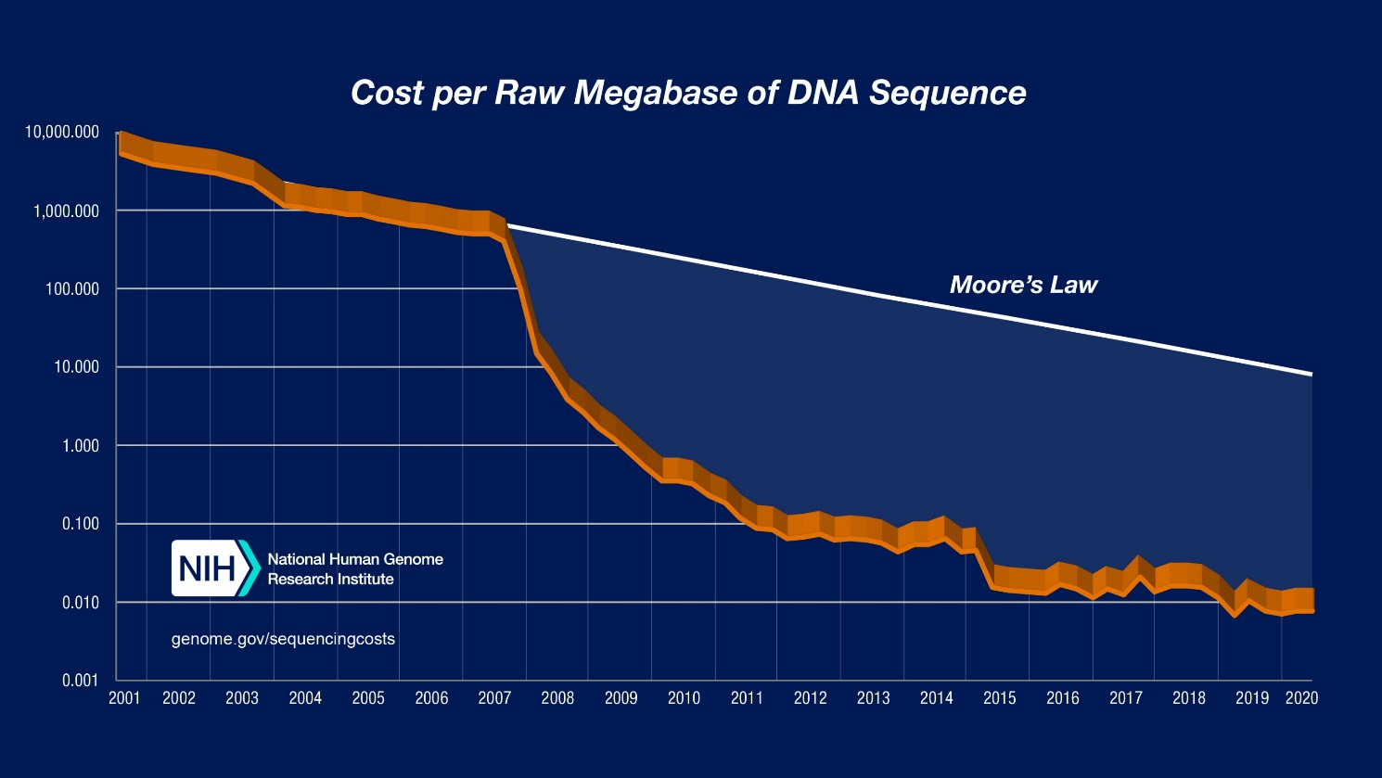
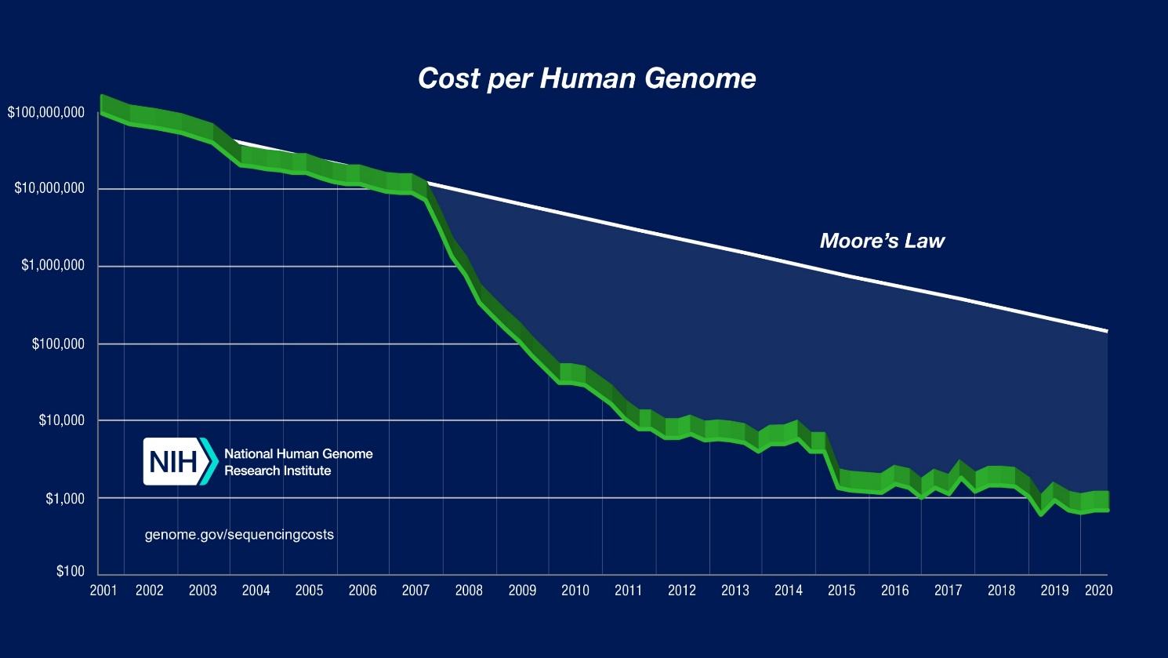
https://www.genome.gov/about-genomics/fact-sheets/DNA-Sequencing-Costs-Data
Isabelle Dupanloup, BCF
Notes:
The cost-accounting data presented here are summarized relative to two metrics: (1) "Cost per Megabase of DNA Sequence" - the cost of determining one megabase (Mb; a million bases) of DNA sequence of a specified quality [see below]; (2) "Cost per Genome" - the cost of sequencing a human-sized genome. For each, a graph is provided showing the data since 2001.
To illustrate the nature of the reductions in DNA sequencing costs, each graph also shows hypothetical data reflecting Moore's Law, which describes a long-term trend in the computer hardware industry that involves the doubling of 'compute power' every two years (See: Moore's Law [wikipedia.org]). Technology improvements that 'keep up' with Moore's Law are widely regarded to be doing exceedingly well, making it useful for comparison.
In both graphs, note: (1) the use a logarithmic scale on the Y axis; and (2) the sudden and profound out-pacing of Moore's Law beginning in January 2008. The latter represents the time when the sequencing centers transitioned from Sanger-based (dideoxy chain termination sequencing) to 'second generation' (or 'next-generation') DNA sequencing technologies. Additional details about these graphs are provided below.
Quality
For the Sanger-based sequence data, the cost accounting reflects the generation of bases with a minimum quality score of Phred20(or Q20), which represents an error probability of 1 % and is an accepted community standard for a high-quality base. For sequence data generated with second-generation sequencing platforms, there is not yet a single accepted measure of accuracy; each manufacturer provides quality scores that are, at this time, accepted by the NHGRI sequencing centers as equivalent to or greater than Q20.
The following 'sequence coverage' values were used in calculating the cost per genome:
Sanger-based sequencing (average read length=500-600 bases): 6-fold coverage
454 sequencing (average read length=300-400 bases): 10-fold coverage
Illumina and SOLiD sequencing (average read length=75-150 bases): 30-fold coverage

Slide 7
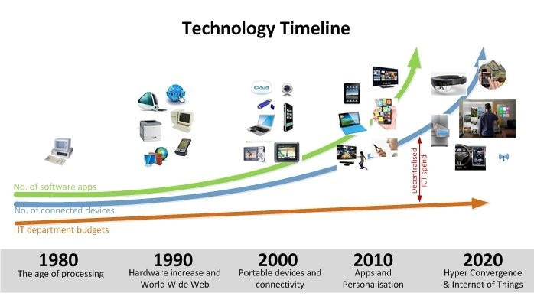
https://www.linkedin.com/pulse/technology-increase-vs-department-budgets-sam-errington/
Isabelle Dupanloup, BCF
Notes:
1980: The first home computer was introduced
1990: Microsoft Windows was shipped for the first time
………………….the human genome project formally launched in 1990 was declared complete on April 14, 2003
2000: Graphics and Games
2010: Mobile Games and Super computing …
2015: AI and Robotics – People like Gates, Musk and Stephen Hawking raise express their fear of AI
2020: Everything is converging and especially we are in the data era now. Covid-19 is being monitored, managed using data, …. Especially with IoT, lost of data are being generated

Slide 8

From data to knowledge
Isabelle Dupanloup, BCF
Notes:
Data is a valuable commodity when it can reduce the time, effort and resources required to solve problems and help us make sound decisions.
Data are facts and represents what has happened e.g. information recorded in the case reports of patients ...it is unstructured
When such data are processed into a context and combined into a structure, information emerges – it gives an interpretation to data, new insights like averages or reports e.g. patient data in tabular formats.
When information is given meaning by interpreting it, i.e. there is an application of data, information becomes knowledge – it brings data from the past to the present.
This wisdom can take us to the future – predicting outcomes.

Slide 9
Some definitions
Artificial Intelligence
programmed by humans to perform human activities
computer systems (AI systems): units of “thinking machines”
General AI Systems can solve problems intelligently
Narrow AI Systems can perform specific tasks very well
AI systems
Intentionality (make decisions from data, predetermined responses)
Intelligence (intelligent decision making)
Adaptability (refine their decision-making capabilities to improve the outcome)
Isabelle Dupanloup, BCF
Notes:
What is Artificial Intelligence?
Historically, both Alan Turing’s “Thinking Machines” and John McCarthy’s “machines that could think autonomously” were the definitions used for AI. As AI Systems evolved, we are now referring to AI as “machines that respond to stimulation consistent with traditional responses from humans, given the human capacity for contemplation, judgment, and intention.”
Artificial Intelligence is just as the word implies, the intelligence is artificial, programmed by humans to perform human activities. This artificial intelligence is incorporated into computer systems to create AI Systems that ultimately functions as units of “thinking machines”.
General AI Systems can solve problems intelligently. (Example: AI-powered Stock Trading System)
Narrow AI Systems can perform specific tasks very well. (Example: AI-powered Manufacturing Arm)
According to Darrell M. West’s report for Brookings Institute, these systems have three qualities: intentionality, intelligence, and adaptability.
Intentionality — Humans design AI systems with the intention of making decisions from historical or real-time data or both. These AI systems contain predetermined responses.
Intelligence — AI systems often incorporate machine learning, deep learning, and data analytics with artificial intelligence that enable intelligent decision making. This intelligence is not human intelligence. It’s the machine’s best approximation to human intelligence.
Adaptability — AI systems have the ability to learn and adapt as they compile information and make decisions. As AI systems learn from real-time data, AI systems can refine their decision-making capabilities to improve the outcome.
Problems best suited for AI to solve:
Repetitive Tasks — Manual tasks that follow logical steps to lead to a conclusion. (Example: packaging goods to be ready for delivery at a warehouse)
Data Intensive Tasks — Tasks involving analyzing large amounts of data looking for patterns and anomaly. (Example: detection of fraud from financial records.)
Super Human Tasks — Tasks that require superhuman capabilities and speaks to the limitations of human sensory skills and fine motor skills. (Example: Robot surgeon can use the most precise movements to perform non-invasive surgeries. Finely tuned computer vision can spot tumors on an MRI when human eyes can not see it.)
Intelligence has been defined in many ways: the capacity for logic, understanding, self-awareness, learning, emotional knowledge, reasoning, planning, creativity, critical thinking, and problem-solving. More generally, it can be described as the ability to perceive or infer information, and to retain it as knowledge to be applied towards adaptive behaviors within an environment or context.

Slide 10
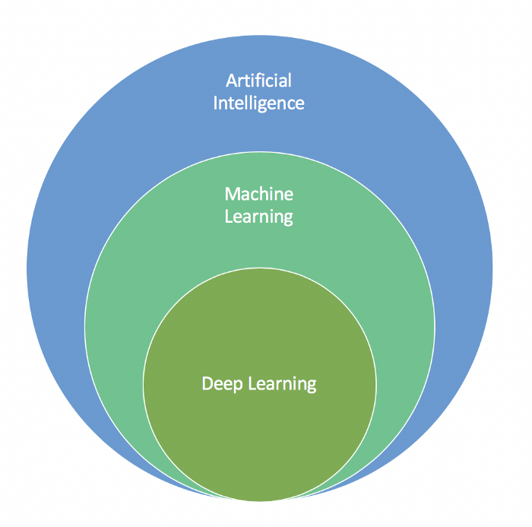
Some definitions
Machine learning
application (or subset) of AI that allows machines to learn from data using general purpose algorithms
variety of algorithms to iteratively learn, describe and improve data in order to predict better outcomes
extensive use of statistical techniques
Isabelle Dupanloup, BCF
Notes:
AI Systems often incorporate artificial intelligence, machine learning, and deep learning to create a sophisticated intelligence machine that will perform given human functions well. Increasingly, all three units are individual pieces of the entire AI System’s intelligence puzzle.
Machine Learning — It is an application of artificial intelligence that provides the AI System with the ability to automatically learn from the environment and applies that learning to make better decisions. There are a variety of algorithms that Machine Learning uses to iteratively learn, describe and improve data in order to predict better outcomes. These algorithms use statistical techniques to spot patterns and then perform actions on these patterns.

Slide 11
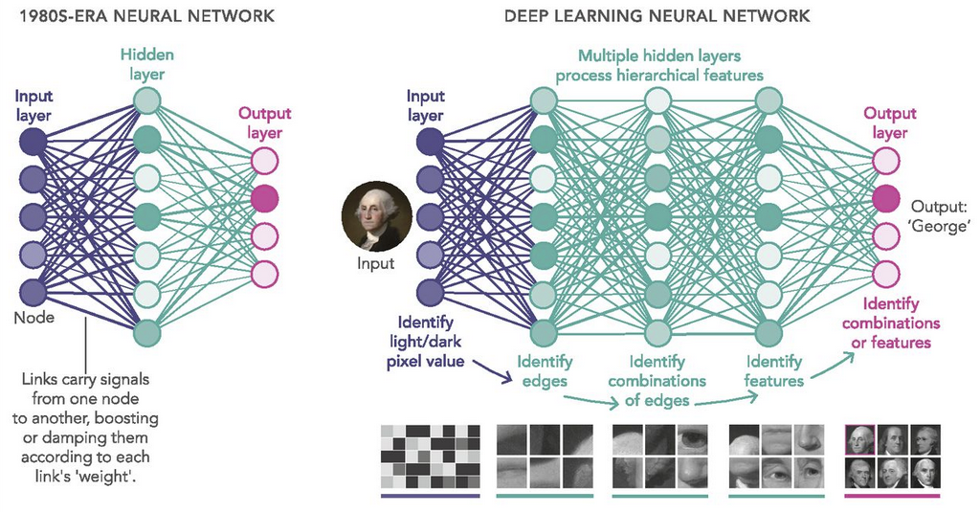
Some definitions
Deep Learning
subset of Machine Learning
use artificial neural networks
analyzes data with a logical structure similar to how a human would draw conclusions
Isabelle Dupanloup, BCF
Notes:
Deep Learning — It is the next generation of Machine Learning. It’s a subset of Machine Learning. Deep Learning models can make their own predictions entirely independent of humans. Machine Learning models of the past still need human intervention in many cases to arrive at the optimal outcome. Deep Learning models use artificial neural networks. The design of this network is inspired by the biological neural network of the human brain. It analyzes data with a logical structure similar to how a human would draw conclusions.
Deep Learning is the next generation of machine learning algorithms that use multiple layers to progressively extract higher level features (or understanding) from raw input. For instance, in image recognition applications, instead of just recognizing matrix pixels, deep learning algorithms will recognize edges at a certain level, nose at another level, and face at yet another level. With the ability to understand data from the lower level all the way up the chain, a deep learning algorithm can improve its performance over time and arrive at decisions at any given moment in time.
The power of deep learning algorithm lies in its ability to take on both supervised learning tasks as well as unsupervised learning tasks. It also approximates many brain development theories of the human brain.
Deep learning algorithms are now used by computer vision systems, speech recognition systems, natural language processing systems, audio recognition systems, bioinformatics systems and medical image analysis systems.

Slide 12
Machine learning
Input Data
Machine Learning
(Model)
Prediction
Learning begins with observations or data
The system looks for patterns in data and makes better decisions in the future based on the examples that we provide
The primary aim is to allow the computers learn automatically without human intervention or assistance and adjust actions accordingly
Isabelle Dupanloup, BCF

Slide 13
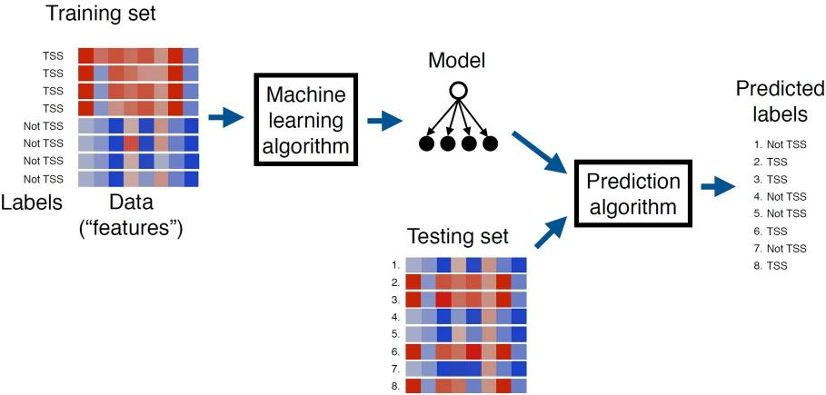
Machine learning in omics
https://www.ncbi.nlm.nih.gov/pmc/articles/PMC5204302/
Isabelle Dupanloup, BCF
Notes:
For example, in genomics machine learning can be used to “learn” how to recognize the locations of transcription start sites (TSSs) in a genome sequence [2]. The process typically proceeds in three stages (Figure 1). First, a machine learning researcher develops an algorithm that they believe will lead to successful learning. Second, the algorithm is provided with a large collection of TSS sequences as well as, optionally, a list of sequences that are known not to be TSSs. The annotation indicating whether a sequence is a TSS or not is known as the label. The algorithm processes these labeled sequences and stores a model. Third, novel, unlabeled sequences are given to the algorithm, and it uses the model to predict labels (“TSS” or “not TSS”) for each sequence. If the learning was successful, then all or most of the predicted labels will be correct. If the labels associated with test set examples are known—i.e., if these examples were held out of the training set on purpose for use in testing the performance of the learning system—then the performance of the machine learning algorithm can be assessed immediately. Otherwise, in a prospective validation setting, the TSS predictions produced by the machine learning system must be tested independently in the lab. Note that this is an example of a subtype of machine learning called “supervised learning”.

Slide 14
Machine learning
Any machine learning problem can be represented with the following three concepts:
We will have to learn to solve a task T.
For example, perform genome annotation.
We will need some experience E to learn to perform the task. Usually, experience is represented through a dataset.
For the gene prediction, experience comes as a set of DNA sequences provided as input to a learning procedure, along with binary labels indicating whether each sequence is centered on a TSS or not. The learning algorithm produces a model which can then be subsequently used, in conjunction with a prediction algorithm, to assign predicted labels to unlabeled test sequences.
We will need a measure of performance P to know how well we are solving the task and also to know whether after doing some modifications, our results are improving or getting worse.
The percentage of genes that our gene prediction model is correctly classifying as genes could be P for our gene prediction task.
Isabelle Dupanloup, BCF

Slide 15
Machine learning in omics
Input data | Task
DNA sequence | Identify transcription start sites, splice sites, exons, etc.
DNA sequence | Identify TF binding sites
DNA sequence | Identify genes
Gene expression | Predict regulatory relationships
Gene expression data | Identify biomarkers for a disease
Histone and TF ChIP-seq data | Partition and label the genome with chromatin state annotation
DNA sequence + gene expression + … | Predict gene function
DNA sequence + histone mods + … | Predict gene expression
DNA sequence + histone mods + … | Predict variant deleteriousness
Sequence variants + gene expression + … | Predict disease phenotype or prognosis
https://www.ncbi.nlm.nih.gov/pmc/articles/PMC5204302/
Isabelle Dupanloup, BCF
Notes:
Machine learning methods have been applied to a huge variety of problems in genomics and genetics (Table 2). Perhaps most significantly, machine learning has been used to annotate a wide variety of genomic sequence elements. In addition to TSSs, algorithms can be trained to identify splice sites [3], promoters [4], enhancers [5], positioned nucleosomes [6], etc. In general, if you can compile a list of sequence elements of a given type, then you can probably train a machine learning method to recognize those elements. Furthermore, models that each recognize an individual type of genomic elements can be combined, along with (learned) logic about their relative locations, to build machine learning systems capable of annotating genes, including their full UTR/intron/exon structure, along entire eukaryotic chromosomes [7].
In addition to learning to recognize patterns in DNA sequences, machine learning can take as input data generated by other genomic assays, such as microarray or RNA-seq expression data, chromatin accessibility assays such as DNase-seq, MNase-seq, and FAIRE, or histone modification, transcription factor (TF) binding ChIP-seq data, etc. Gene expression data can be used to learn to distinguish between different disease phenotypes and, in the process, to identify potentially valuable disease biomarkers (Section 6). Chromatin data can be used, for example, to annotate the genome in an “unsupervised” fashion, thereby potentially allowing for the identification of novel classes of functional elements (Section 2).
Machine learning has also been used extensively to assign functional annotations to genes. Such annotations most frequently take the form of Gene Ontology term assignments [8]. Predictive algorithms can take as input any one or more of a wide variety of data types, including the genomic sequence, gene expression profiles across various experimental conditions or phenotypes, protein-protein interactions, synthetic lethality data, open chromatin data, histone modification or TF binding ChIP-seq data, etc. As an alternative to GO term prediction, some predictors instead identify co-functional relationships; i.e., the machine learning method outputs a network in which genes are nodes and an edge between genes A and B indicates that the two genes share a common function [9].
Finally, a wide variety of machine learning methods have been developed to help understand the mechanisms underlying gene expression. Some techniques aim to predict the expression of a gene based solely on the DNA sequence [10], whereas others take into account ChIP-seq histone modification [11] or TF binding [12] profiles at the gene promoter region. More sophisticated methods attempt to jointly model the expression of all genes in a cell by training a network model [13]. Like a co-functional network, each node in a gene expression network is a gene; however, edges in this case represent, for example, regulatory relationships between TFs and their targets.
ChIP-seq is a method used to analyze protein interactions with DNA. ChIP-seq combines chromatin immunoprecipitation with DNA sequencing to infer the possible binding sites of DNA-associated proteins. The ENCODE consortium has developed two analysis pipelines to study two different classes of protein-chromatin interactions. The transcription factor ChIP-seq (TF ChIP-seq) pipeline, described here, is suitable for proteins that are expected to bind in a punctate manner, such as to specific DNA sequences or specific chromatin configurations. I

Slide 16
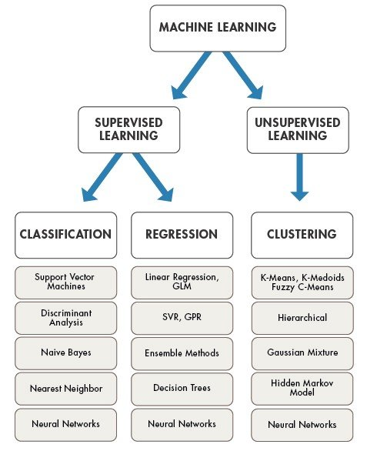
Machine learning taxonomy
DIMENSIONALITY
REDUCTION
Principal component analysis
Isabelle Dupanloup, BCF

Slide 17
Supervised versus unsupervised learning
Supervised learning
Machine learning algorithm that is trained on labeled examples and used to predict the label of unlabeled examples.
Prediction limited to input labels
Unsupervised learning
Machine learning algorithm that does not require labels, such as a clustering algorithm.
Prediction of new labels
Semi-supervised learning
Reinforcement Learning
Isabelle Dupanloup, BCF
Notes:
Machine learning methods can usefully be segregated into two primary categories: supervised versus unsupervised methods. To illustrate the difference between the two, consider again the gene finding problem: given the DNA sequence of a chromosome, the goal of a gene finding algorithm is to predict the locations and detailed intron/exon structure of all of the protein-coding genes on the chromosome (Figure 2).
The most straightforward solution to this problem leverages what we already know about the genome to help us build a predictive model. In particular, a supervised learning algorithm for gene finding requires as input a training set of labeled DNA sequences, where the labels specify the locations of the start and end of the gene (TSS and TTS) as well as all of the splice sites in between. The model then uses this training data to learn general properties of genes, such as what DNA sequence pattern typically occurs near a donor or acceptor splice site, the fact that in-frame stop codons should not occur within coding exons, the expected length distributions of 5' and 3' untranslated regions (UTRs) and of initial, internal and final introns, etc. The trained model can then use these learned properties to identify novel genes that resemble the genes in the training set.
If we are interested in discovering what types of labels best explain the data rather than imposing a pre-determined set of labels on the data, then we must use unsupervised rather than supervised learning. In this type of approach, the machine learning algorithm takes as input only the unlabeled data and the desired number of different labels to assign [19, 20, 21]. The algorithm then automatically partitions the genome into segments and assigns a label to each segment, with the goal of assigning the same label to segments that have similar data. Because the method is unsupervised, a human must subsequently assign semantics to each label, a step which is not required for a supervised gene finding algorithm. The benefit of the unsupervised approach, however, is the ability to train when labeled examples are unavailable and the ability to identify potentially novel types of genomic elements. The latter is fundamentally impossible with a supervised method, which can only identify more examples of the types of labels it learns from.
If we are interested in discovering what types of labels best explain the data rather than imposing a pre-determined set of labels on the data, then we must use unsupervised rather than supervised learning. In this type of approach, the machine learning algorithm takes as input only the unlabeled data and the desired number of different labels to assign [19, 20, 21]. The algorithm then automatically partitions the genome into segments and assigns a label to each segment, with the goal of assigning the same label to segments that have similar data. Because the method is unsupervised, a human must subsequently assign semantics to each label, a step which is not required for a supervised gene finding algorithm. The benefit of the unsupervised approach, however, is the ability to train when labeled examples are unavailable and the ability to identify potentially novel types of genomic elements. The latter is fundamentally impossible with a supervised method, which can only identify more examples of the types of labels it learns from.
Intermediate between supervised and unsupervised learning is semi-supervised learning [22]. In supervised learning, the algorithm receives as input a collection of data points, each with an associated label, whereas in unsupervised learning, the algorithm receives the data but no labels. The semi-supervised setting is a mixture of these two: the algorithm receives a collection of data points, but only a subset of those points have associated labels. In practice, gene finding systems are often trained using a semi-supervised approach, where the input is a collection of annotated genes plus a complete (unlabeled) genome sequence. The learning procedure begins by constructing an initial gene finding model based solely on the labeled subset of the training data. Then the model is used to scan the genome, and tentative labels are assigned throughout the genome. These tentative labels can then be used to improve the learned model, and the procedure iterates until no new genes are found. The semi-supervised approach can work much better than a fully supervised approach because the model is able to learn from a much larger set of genes: all genes in the genome, rather than only the subset of genes that have been identified with high confidence.
Reinforcement Learning: A system interacts with a dynamic environment in which it must perform a certain goal (such as driving a vehicle or playing a game against an opponent). The system is provided feedback in terms of rewards and punishments as it navigates its problem space.

Slide 18
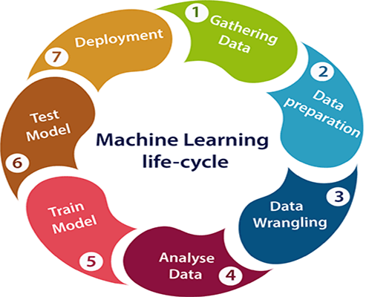
https://www.javatpoint.com/machine-learning-life-cycle

Slide 19
Understand Your Data
Are data consistent?
Are there outliers or wrongly annotated datapoints?
Are there biases, especially if data comes frome different labs or measurement devices?
Is there anough data for what I want to do?
What can I do to handle very large data?

Slide 20
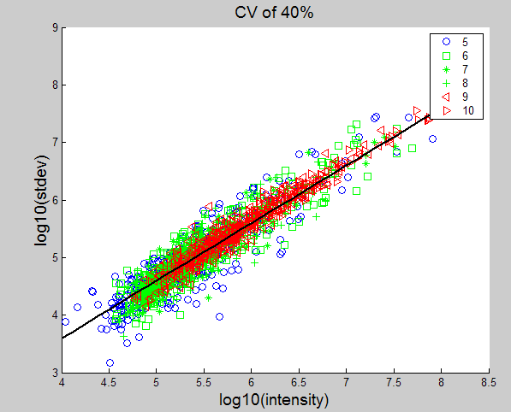
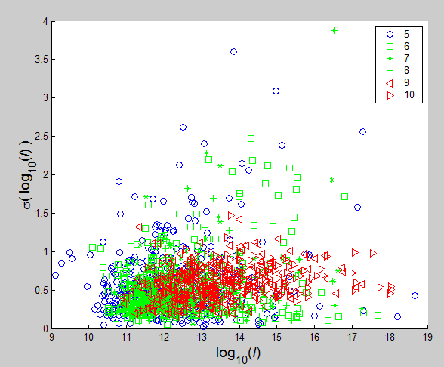
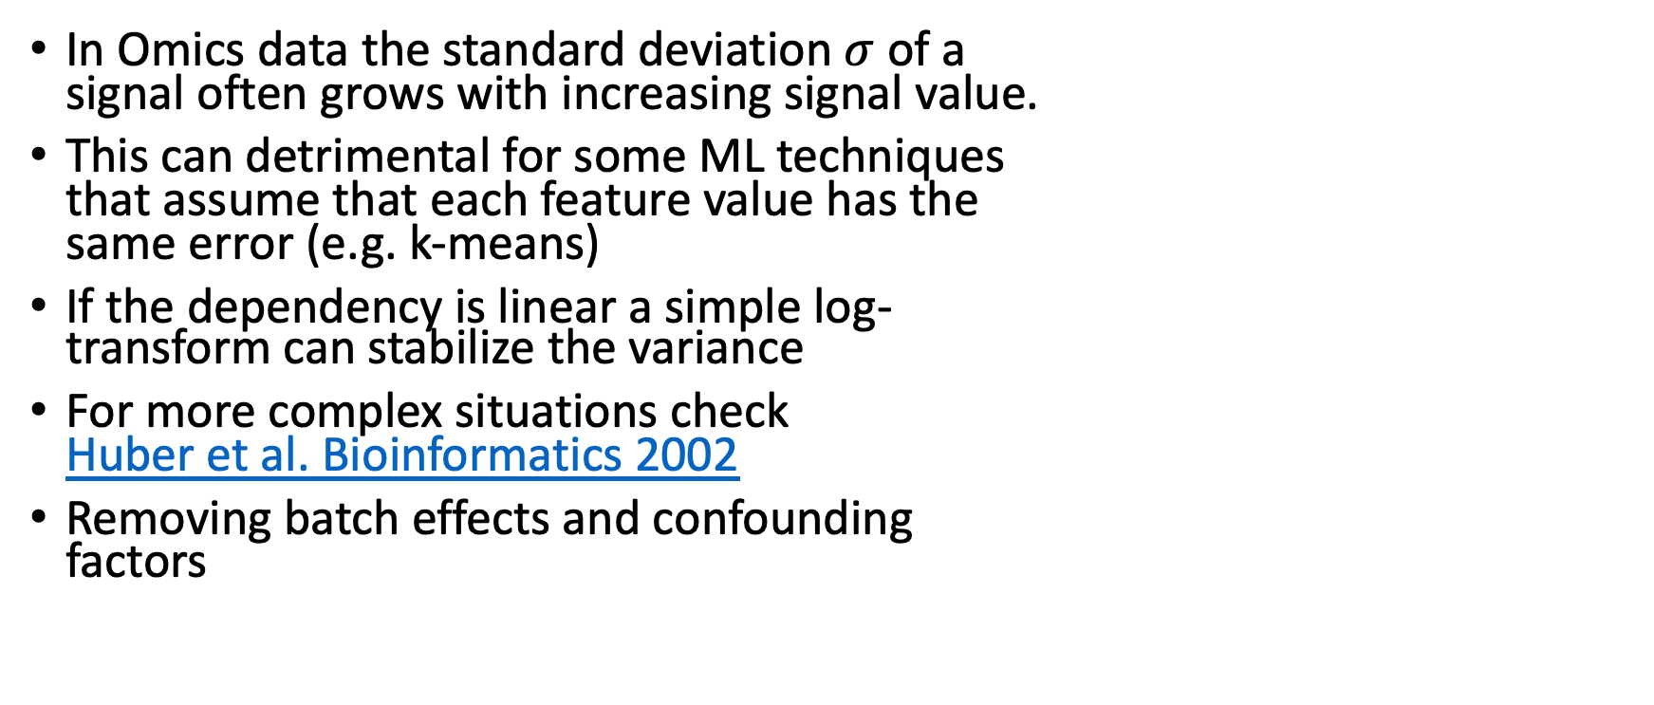
Variance Stabilization
In Omics data the standard deviation $σ$of a signal often grows with increasing signal value.
This can detrimental for some ML techniques that assume that each feature value has the same error (e.g. k-means)
If the dependency is linear a simple log- transform can stabilize the variance
For more complex situations check Huber et al. Bioinformatics 2002
Removing batch effects and confounding factors

Slide 21
Missing Values (MV)
Omics data (especially proteomics) often have missing values, which can be caused by leaky measurement or data processing
There are two main strategies to deal with MVs: discard or impute them
MVs can occur at random or depend on feature values
For missing at random we can only replace or impute them by the best guess, the global non-missing mean (Donders et al, J. Clin. Epi., 2006)
In the latter case, we can try to predict the MVs using the feature values by EM, KNN, SVD, or regression technique (Troyanskaya et al, Bioinformatics, 2001)

Slide 22
Feature Selection
Many ML methods work better when the number of noisy features is small (curse of dimensionality)
Feature selection is a way to detect uninformative features and remove them before applying the ML method.
sklearn offers various feature selection methods in sklearn.feature_selection

Slide 23
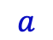
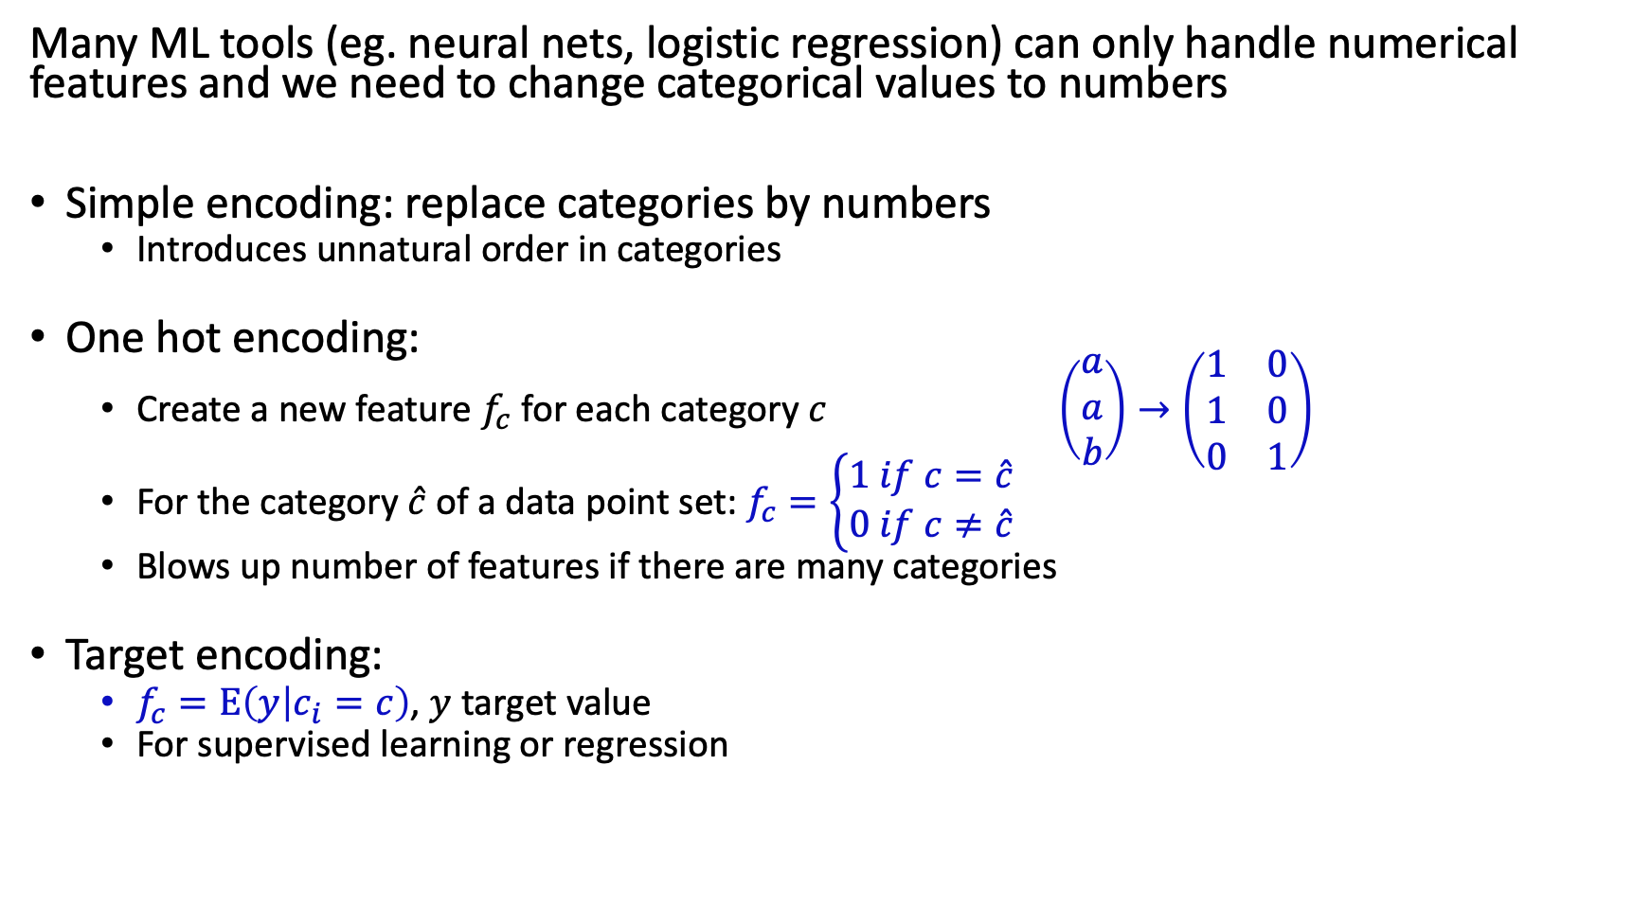
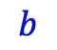
Turning categorical values into numerical ones
Many ML tools (eg. neural nets, logistic regression) can only handle numerical features and we need to change categorical values to numbers
Simple encoding: replace categories by numbers
Introduces unnatural order in categories
One hot encoding:
Create a new feature $f_{c}$ for each category $c$ $\left(\begin{matrix}a \\ a \\ b\end{matrix}\right)→\left(\begin{matrix}1 & 0 \\ 1 & 0 \\ 0 & 1\end{matrix}\right)$
For the category $\hat{c}$ of a data point set: $f_{c}=\left\{\begin{aligned}1 if c=\hat{c} \\ 0 if c≠\hat{c}\end{aligned}\right.$
Blows up number of features if there are many categories
Target encoding:
$f_{c}=E\left(y | c_{i}=c\right)$, $y$ target value
For supervised learning or regression
$$a$$
$$b$$

Slide 24
Unsupervised machine learning algorithms
Dimensionality Reduction
Often we are working with data of high dimensionality - each observation comes with a high number of measurements - a dimension reduction procedure is usually conducted to reduce the variable space before the subsequent analysis is carried out..
Clustering
= discover groupings inside the input data (example: cluster DNA sequences into functional groups).
Association
= discover rules inside the input data (learn relationships between the measurements)
Isabelle Dupanloup, BCF

Slide 25
Reproducibility in machine learning
Reproducibility: a ML research finding is reproducible if the code and data used to obtain the finding are available and the data is correctly analyzed
Computational reproducibility: other researchers should be able to replicate the results of a model, given the full details on data, code and conditions.
Credibility of ML relies on reproducibility
Irreproducible results can easily arise in ML (Kapoor and Narayanan, arXiv, 2022)
The most prominent source of error is ‘data leakage’ (see below), when information from the test data is included in the training data.
See reproducibility workshop from Princeton University
Markus Müller, SIB

Slide 26
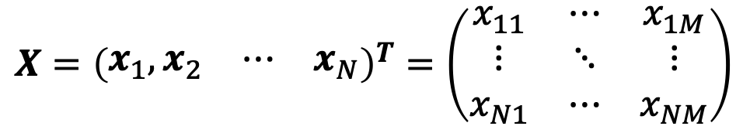
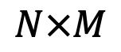
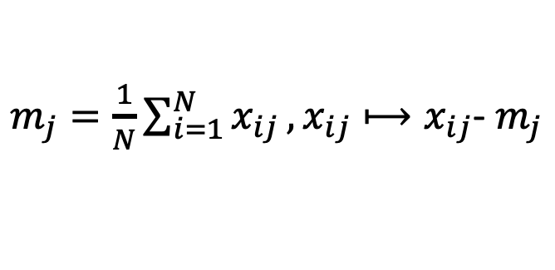
Some Notations:
M features or conditions
$$X={\left(\begin{matrix}x_{1},x_{2} & ⋯ & x_{N}\end{matrix}\right)}^{T}=\left(\begin{matrix}x_{11} & ⋯ & x_{1M} \\ ⋮ & ⋱ & ⋮ \\ x_{N1} & ⋯ & x_{NM}\end{matrix}\right)$$
Data matrix:
N items
$$N×M$$
Zero centering:
$m_{j}=\frac{1}{N}\sum_{i=1}^{N}{x_{ij}},x_{ij}⟼x_{ij}$- $m_{j}$
Columns have 0 means

Slide 27
Principal components analysis (PCA)
Mathematical algorithm that reduces the dimensionality of the data while retaining most of the variation in the data set
Identifies orthogonal directions, called principal components, along which the variation in the data is maximal
By using a few components, each sample can be represented by relatively few numbers instead of thousands of variables.
Samples can then be plotted, making it possible to visually assess similarities and differences between samples and determine whether samples can be grouped.
Isabelle Dupanloup, BCF

Slide 28
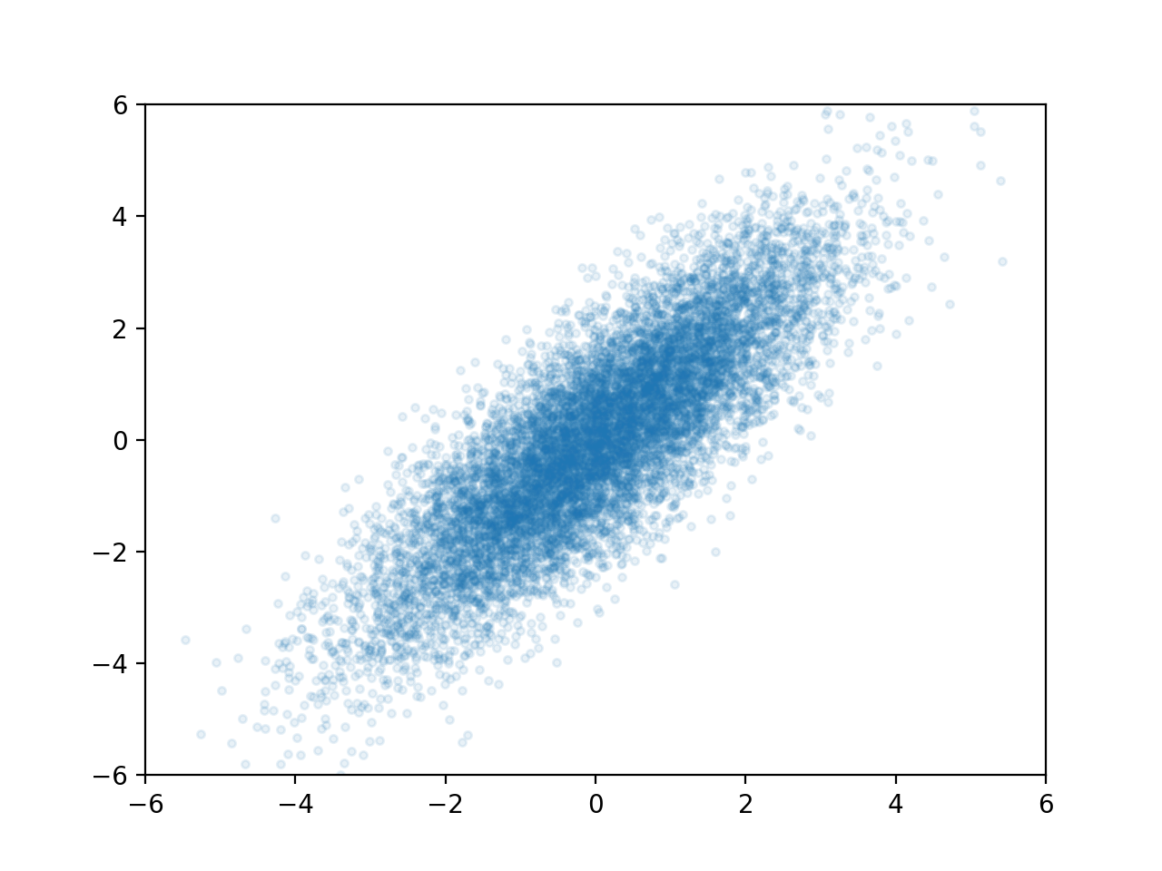
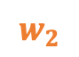
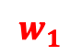
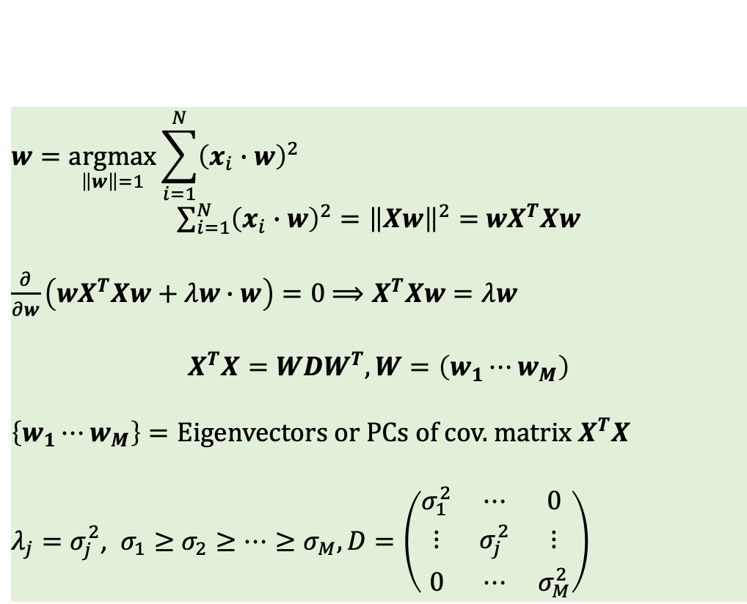
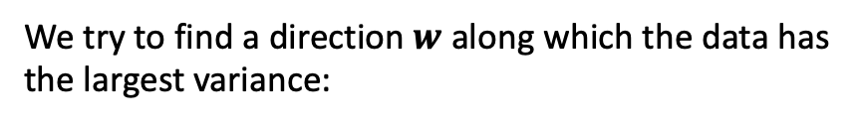

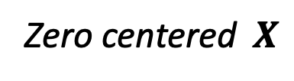
Principal Component Analysis (PCA)
We try to find a direction $w$ along which the data has
the largest variance:
Zero centered$X$
$$w=\underset{\left\|w\right\|=1}{argmax}{\sum_{i=1}^{N}{{\left(x_{i}∙w\right)}^{2}}}$$
$\sum_{i=1}^{N}{{\left(x_{i}∙w\right)}^{2}}={\left\|Xw\right\|}^{2}=$ $wX^{T}Xw$
$\frac{∂}{∂w}\left(wX^{T}Xw+λw∙w\right)=0$ $⟹X^{T}Xw=λw$
$$X^{T}X=WDW^{T},W=\left(w_{1}⋯w_{M}\right)$$
$\left\{w_{1}⋯w_{M}\right\}=\text{Eigenv}\text{ectors} \text{or} \text{PCs} \text{of} \text{cov}\text{.} \text{matrix}$ $X^{T}X$
$λ_{j}=σ_{j}^{2}$, $σ_{1}≥$ $σ_{2}≥⋯≥σ_{M}, D=\left(\begin{matrix}σ_{1}^{2} & ⋯ & 0 \\ ⋮ & σ_{j}^{2} & ⋮ \\ 0 & ⋯ & σ_{M}^{2}\end{matrix}\right)$
$$w_{2}$$
$$w$$
$$w_{1}$$

Slide 29
Principal Component Analysis (PCA)
Dimension reduction and visualization
Decorrelate or whiten signals
Data compression

Slide 30
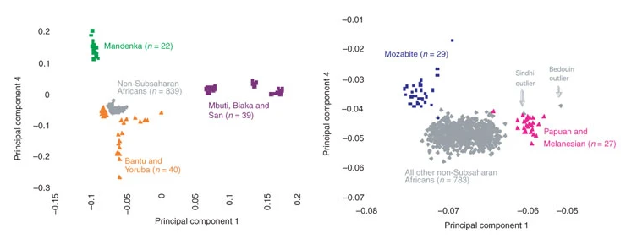
Principal components analysis (PCA)
Reich et al. (2008) Nature Genetics.
Isabelle Dupanloup, BCF
Notes:
David Reich, Alkes L Price & Nick Patterson
Nature Genetics volume 40, pages 491–492 (2008)
Dataset of 940 individuals from 53 populations typed at ∼650,000 SNPs as part of the Human Genome Diversity Project¹¹. We used EIGENSOFT^{8,9} to find the principal axes of genetic variation in the seven sub-Saharan African populations in this dataset and then projected all samples on the resulting PCs. The non-African populations fell into a rough cluster (Fig. 1a), which is about what would be expected if all non-African populations were founded by a single dispersal 'out of Africa‘.
We carried out PCA on 940 individuals from the Human Genome Diversity Project that were scanned at approximately 650,000 SNPs¹¹ using data from 101 sub-Saharan African samples to define the PCs (Mandenka, Bantu from Kenya and South Africa, Yoruba, San, Mbuti Pygmy and Biaka Pygmy). We carried out the analysis on samples blinded to population labels (the coloring of samples was only carried out after the analysis). We plotted principal component 1 (negative values are more Bantu-related) and principal component 4 (positive values are more closely related to the Senegalese Mandenka). (b) Outlying populations are the Mozabite, who are more Mandenka-related, reflecting recent gene flow across the Sahara, and Papuans and Melanesians, who have inherited less Bantu-related gene flow.

Slide 31
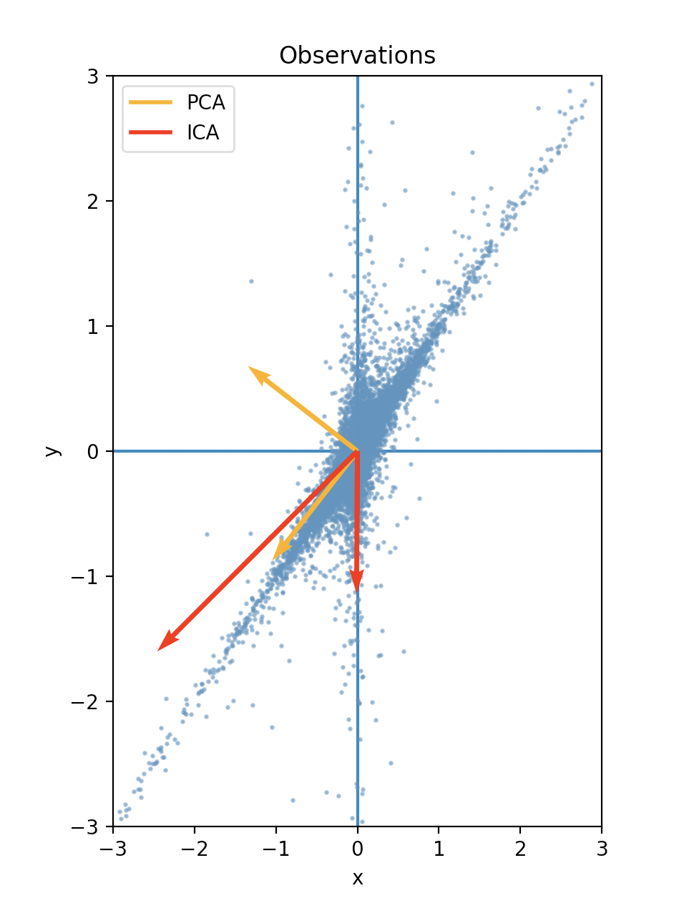
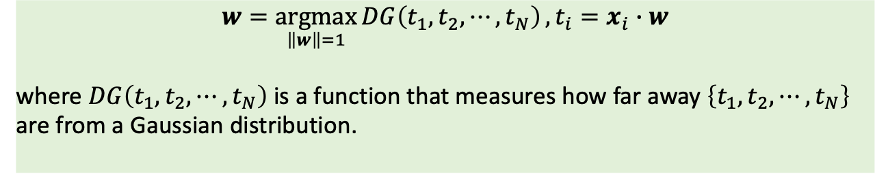
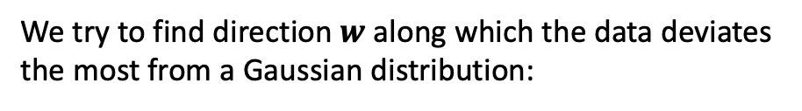
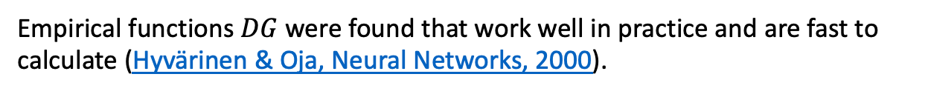
Independent Component Analysis (ICA)
We try to find direction $w$ along which the data deviates
the most from a Gaussian distribution:
$$w=\underset{\left\|w\right\|=1}{argmax}{DG\left(t_{1},t_{2},⋯,t_{N}\right)},t_{i}=x_{i}∙w$$
where $DG\left(t_{1},t_{2},⋯,t_{N}\right)$ is a function that measures how far away $\left\{t_{1},t_{2},⋯,t_{N}\right\}$ are from a Gaussian distribution.
Empirical functions $DG$ were found that work well in practice and are fast to calculate (Hyvärinen & Oja, Neural Networks, 2000).

Slide 32
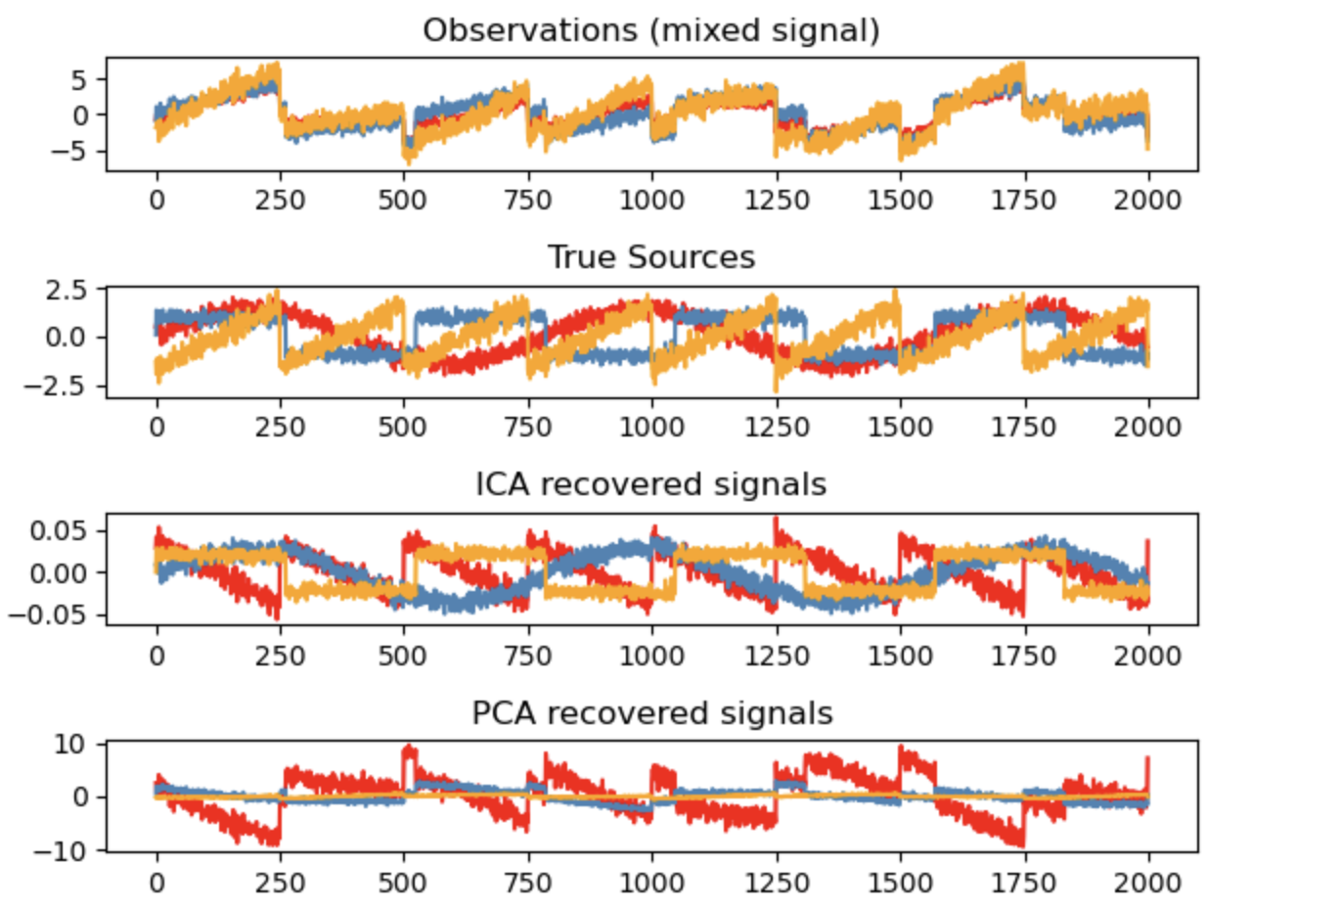
Independent Component Analysis (ICA)

Slide 33
Multidimensional scaling (MDS)
visual representation of distances between sets of objects
objects that are more similar (or have smaller distances) are closer together on the MDS than objects that are less similar (or have larger distances)
MDS can also serve as a dimension reduction technique for high-dimensional data
Isabelle Dupanloup, BCF

Slide 34
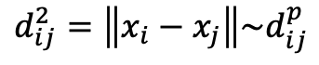
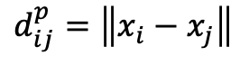
Multidimensional scaling (MDS)
Step by step
Assign points to arbitrary coordinates in p-dimensional space.
Compute euclidean distances among all pairs of points
Compare the similarity matrix with the original input matrix by evaluating the stress function. Stress is a goodness-of-fit measure, based on differences between predicted and actual distances.
Adjust coordinates of each point in the direction that reduces stress.
Repeat steps 2 through 4 until stress can’t be minimized further.
$$d_{ij}^{p}=\left\|x_{i}−x_{j}\right\|$$
$$d_{ij}^{2}=\left\|x_{i}−x_{j}\right\|\sim d_{ij}^{p}$$
MDS
Markus Müller, SIB
Notes:
Stress is a goodness-of-fit measure, based on differences between predicted and actual distances. In his original 1964 MDS paper, Kruskal wrote that fits close to zero are excellent, while anything over .2 should be considered “poor”. More recent authors suggest evaluating stress based on the quality of the distance matrix and how many objects are in that matrix.

Slide 35
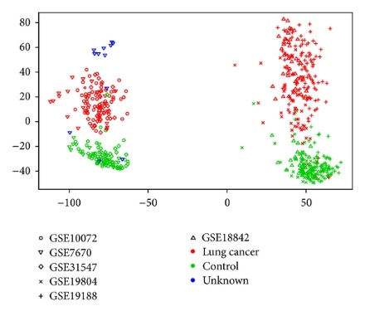
Multidimensional scaling (MDS)
Taminau et al. (2014) ISRN Bioinform.
Isabelle Dupanloup, BCF
Notes:
Analysis of six publicly available lung cancer microarray data
adenocarcinoma and non-tumor tissue samples
From this MDS plot we can see that the biggest source of variation is rather technical than biological since all samples are clustered in two groups corresponding to the two different platforms they were assayed on. It could be expected that this undesirable effect would influence the discovery of DEGs. Based on our results this is however not the case and the explanation lies in the fact that MDS plots provide a global view on the data, while the identification of DEGs is more based on local effects, that is, the specific expression of one gene in certain conditions. The explanation for this apparently paradoxical result is in the fact that not all genes are affected by batch effect removal in the same way. Genes which are differentially expressed in individual studies could still remain differentially expressed after data merging with no batch effect correction, if their expression is not much affected by batch effects. Moreover, even if a gene is affected by batch effects we observed that the difference between the two modes or conditions of the gene (in our case control versus lung cancer) is almost always preserved over all samples of the merged data set.
GPL96 Affymetrix Human hgu133a Array: GSE10072, GSE7670, GSE31547
GPL570 Affymetrix GeneChip: GSE19804, GSE19188, GSE18842
microarrays

Slide 36
t-distributed Stochastic Neighbor Embedding (t-SNE)
unsupervised, non-linear technique primarily used for data exploration and visualizing high-dimensional data
In concept similar to MDS, but with improved distance metrics
t-SNE differs from PCA by preserving only small pairwise distances or local similarities whereas PCA is concerned with preserving large pairwise distances to maximize variance
maps a set of high-dimensional points to two dimensions, such that close neighbours remain close and distant points remain distant
Isabelle Dupanloup, BCF

Slide 37
t-distributed Stochastic Neighbor Embedding (t-SNE)
Informally, the algorithm places all points on the 2D plane, initially at random positions, and lets them interact as if they were physical particles.
The interaction is governed by two laws: first, all points are repelled from each other; second, each point is attracted to its nearest neighbours
The most important parameter of t-SNE, called perplexity, determines how many of its nearest neighbours each point is attracted to.
Isabelle Dupanloup, BCF

Slide 38
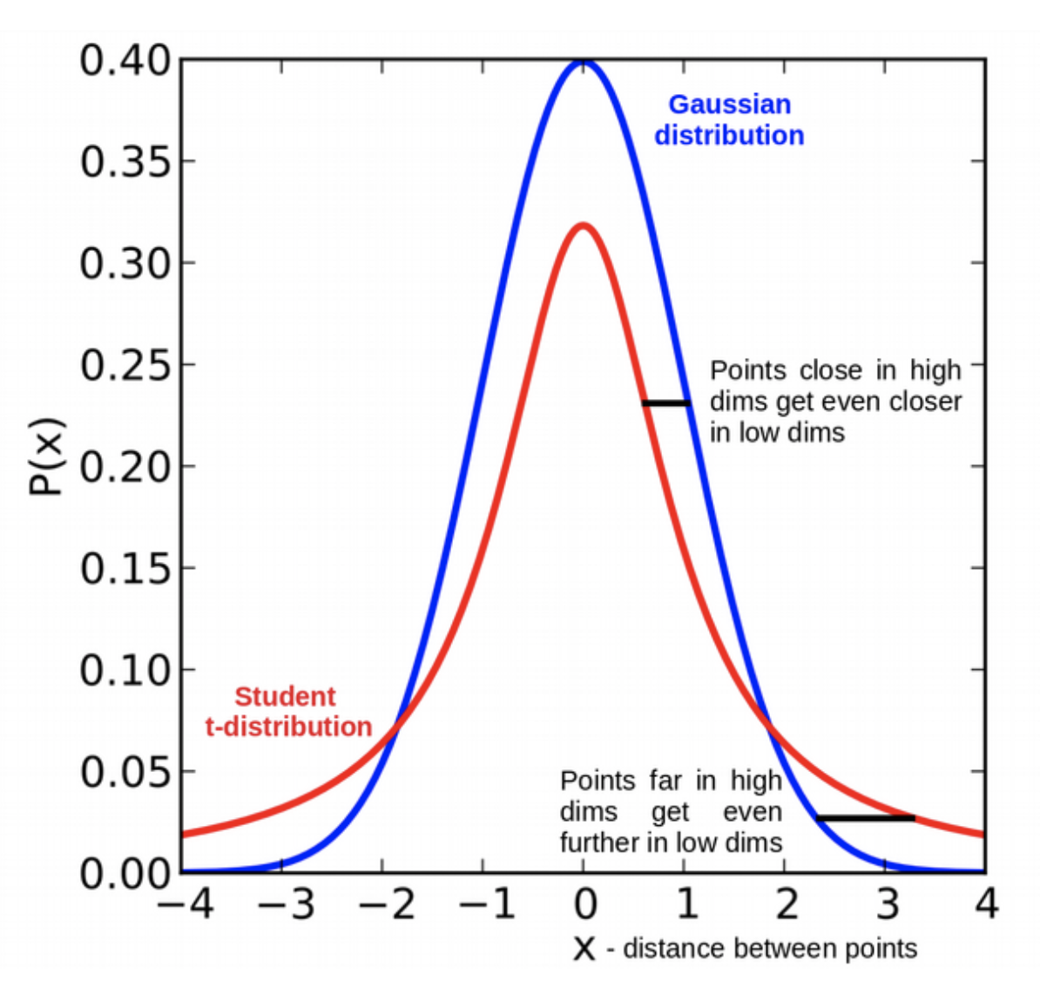
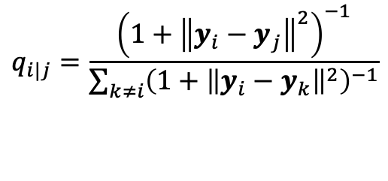
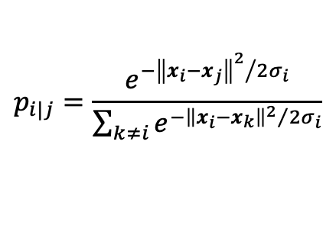
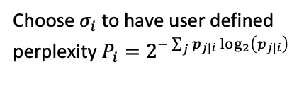
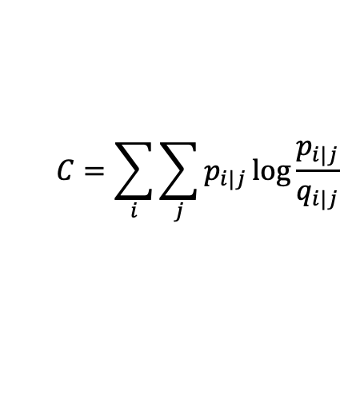
t-distributed Stochastic Neighborhood Embedding (t-SNE)
Choose $σ_{i}$ to have user defined
perplexity $P_{i}=2^{−\sum_{j}{p_{j|i}}\log_{2}\left(p_{j|i}\right)}$
$$p_{i|j}=\frac{e^{{−{\left\|x_{i}−x_{j}\right\|}^{2}}/{2σ_{i}}}}{\sum_{k≠i}{e^{{−{\left\|x_{i}−x_{k}\right\|}^{2}}/{2σ_{i}}}}}$$
$$q_{i|j}=\frac{{\left(1+{\left\|y_{i}−y_{j}\right\|}^{2}\right)}^{−1}}{\sum_{k≠i}{{\left(1+{\left\|y_{i}−y_{k}\right\|}^{2}\right)}^{−1}}}$$
t-SNE
optimize
$$C=\sum_{i}{\sum_{j}{p_{i|j}}\log{\frac{p_{i|j}}{q_{i|j}}}}$$
Maaten & Hinton, JMLR, 2008

Slide 39
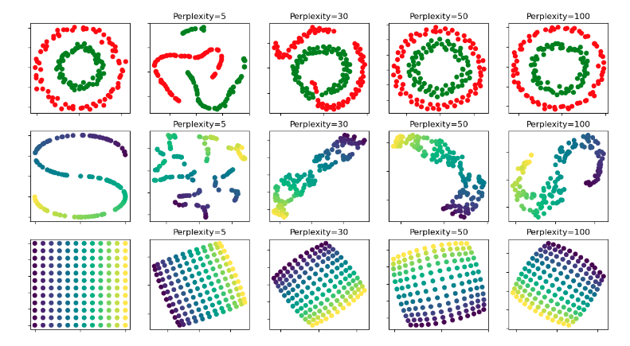
t-SNE Perplexity
https://scikit-learn.org/stable/auto_examples/manifold/plot_t_sne_perplexity.html
The larger the perplexity, the more neighbours are considered and the more the global structure is preserved
Markus Müller, SIB

Slide 40
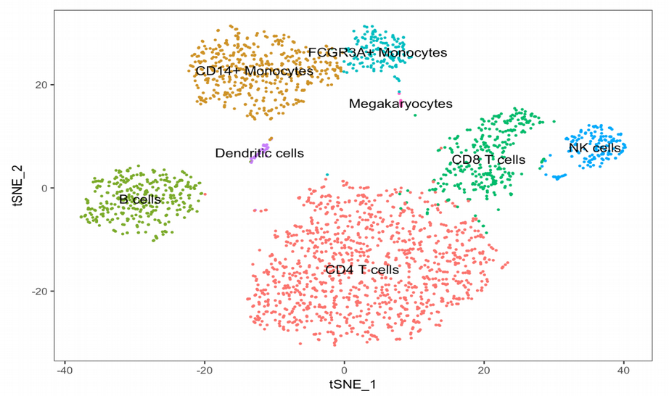
t-distributed Stochastic Neighbor Embedding (t-SNE)
https://towardsdatascience.com/how-to-tune-hyperparameters-of-tsne-7c0596a18868
Isabelle Dupanloup, BCF
Notes:
tSNE does not scale well for rapidly increasing sample sizes in scRNAseq. Attempts to speed it up with FItSNE lead to large memory consumption making it impossible to do the analysis outside of computer cluster.
tSNE does not preserve global data structure, meaning that only within cluster distances are meaningful while between cluster similarities are not guaranteed, therefore it is widely acknowledged that clustering on tSNE is not a very good idea.
tSNE can practically only embed into 2 or 3 dimensions, i.e. only for visualization purposes, so it is hard to use tSNE as a general dimension reduction technique in order to produce e.g. 10 or 50 components. Please note, this is still a problem for the more modern FItSNE algorithm.
tSNE performs a non-parametric mapping from high to low dimensions, meaning that it does not leverage features (aka PCA loadings) that drive the observed clustering.
tSNE can not work with high-dimensional data directly, Autoencoder or PCA are often used for performing a pre-dimensionality reduction before plugging it into the tSNE
tSNE consumes too much memory for its computations which becomes especially obvious when using large perplexity hyperparameter since the k-nearest neighbor initial step (like in Barnes-Hut procedure) becomes less efficient and important for time reduction. This problem is not solved by the more modern FItSNE algorithm either.
Seurat: Run Non-linear dimensional reduction (tSNE)
Seurat continues to use tSNE as a powerful tool to visualize and explore these datasets. While we no longer advise clustering directly on tSNE components, cells within the graph-based clusters determined above should co-localize on the tSNE plot. This is because the tSNE aims to place cells with similar local neighborhoods in high-dimensional space together in low-dimensional space. As input to the tSNE, we suggest using the same PCs as input to the clustering analysis, although computing the tSNE based on scaled gene expression is also supported using the genes.use argument.
How to (mis)read UMAP
While UMAP offers a number of advantages over t-SNE, it's by no means a silver bullet - and reading and understanding its results requires some care. It's worth revisiting our previous work on (mis)reading t-SNE, since many of the same takeaways apply to UMAP:
1. Hyperparameters really matter
Choosing good values isn't easy, and depends on both the data and your goals (eg, how tightly packed the projection ought to be). This is where UMAP's speed is a big advantage - By running UMAP multiple times with a variety of hyperparameters, you can get a better sense of how the projection is affected by its parameters.
2. Cluster sizes in a UMAP plot mean nothing
Just as in t-SNE, the size of clusters relative to each other is essentially meaningless. This is because UMAP uses local notions of distance to construct its high-dimensional graph representation.
3. Distances between clusters might not mean anything
Likewise, the distances between clusters is likely to be meaningless. While it's true that the global positions of clusters are better preserved in UMAP, the distances between them are not meaningful. Again, this is due to using local distances when constructing the graph.
4. Random noise doesn’t always look random.
Especially at low values of n_neighbors, spurious clustering can be observed.
5. You may need more than one plot
Since the UMAP algorithm is stochastic, different runs with the same hyperparameters can yield different results. Additionally, since the choice of hyperparameters is so important, it can be very useful to run the projection multiple times with various hyperparameters.

Slide 41
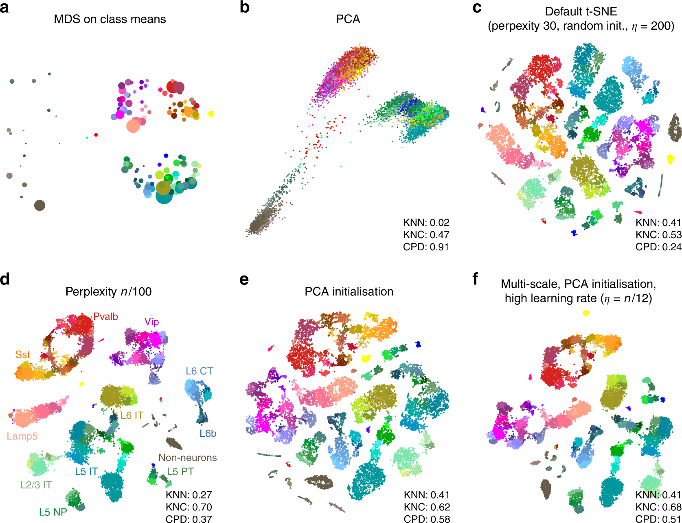
t-distributed Stochastic Neighborhood Embedding (t-SNE)
Single cell analysis
Kobab & Berens, Nature Comm., 2019

Slide 42
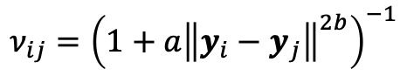
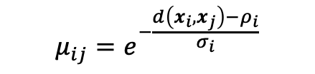
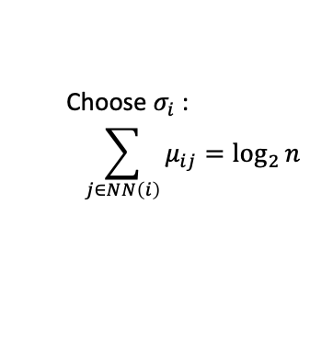
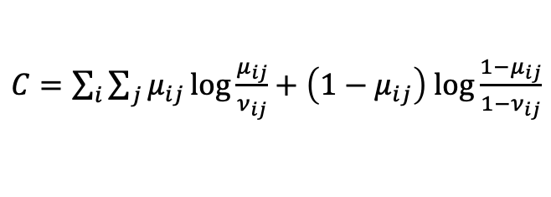
Uniform manifold approximation and projection (UMAP)
Choose $σ_{i}$ :
$$\sum_{j∈NN\left(i\right)}{μ_{ij}}=\log_{2}{n}$$
$$μ_{ij}=e^{−\frac{d\left(x_{i},x_{j}\right)−ρ_{i}}{σ_{i}}}$$
$$ν_{ij}={\left(1+a{\left\|y_{i}−y_{j}\right\|}^{2b}\right)}^{−1}$$
UMAP
Initialize with SpecClust
& optimize
$C=\sum_{i}{\sum_{j}{μ_{ij}}\log{\frac{μ_{ij}}{ν_{ij}}}}+\left(1−μ_{ij}\right)$ $\log{\frac{{1−μ}_{ij}}{1−ν_{ij}}}$
McInnes et al.,arxiv, 2018

Slide 43
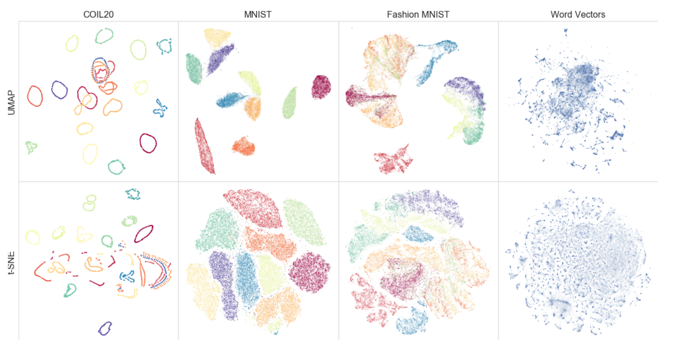
T-SNE versus UMAP
McInnes et al., 2018
Nikolay Oskolkov’s blog
Notes:
How to (mis)read UMAP
While UMAP offers a number of advantages over t-SNE, it's by no means a silver bullet - and reading and understanding its results requires some care. It's worth revisiting our previous work on (mis)reading t-SNE, since many of the same takeaways apply to UMAP:
1. Hyperparameters really matter
Choosing good values isn't easy, and depends on both the data and your goals (eg, how tightly packed the projection ought to be). This is where UMAP's speed is a big advantage - By running UMAP multiple times with a variety of hyperparameters, you can get a better sense of how the projection is affected by its parameters.
2. Cluster sizes in a UMAP plot mean nothing
Just as in t-SNE, the size of clusters relative to each other is essentially meaningless. This is because UMAP uses local notions of distance to construct its high-dimensional graph representation.
3. Distances between clusters might not mean anything
Likewise, the distances between clusters is likely to be meaningless. While it's true that the global positions of clusters are better preserved in UMAP, the distances between them are not meaningful. Again, this is due to using local distances when constructing the graph.
4. Random noise doesn’t always look random.
Especially at low values of n_neighbors, spurious clustering can be observed.
5. You may need more than one plot
Since the UMAP algorithm is stochastic, different runs with the same hyperparameters can yield different results. Additionally, since the choice of hyperparameters is so important, it can be very useful to run the projection multiple times with various hyperparameters.

Slide 44
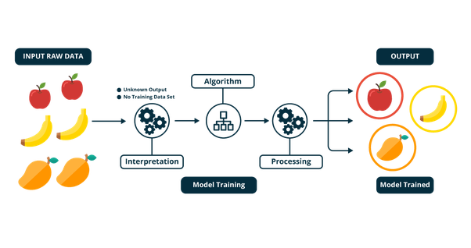
Unsupervised learning
Isabelle Dupanloup, BCF

Slide 45
Unsupervised machine learning algorithms
In contrast to supervised machine learning algorithms, they:
are applied when the information used to train is neither classified nor labeled.
can infer a function to describe a hidden structure from unlabeled data.
do not figure out the right output, but explore the data and can draw inferences from datasets to describe hidden structures from unlabeled data.
The goal for unsupervised learning is to model the underlying structure or distribution in the data in order to learn more about the data.
Isabelle Dupanloup, BCF

Slide 46
Clustering
Pattern detection: discover hidden patterns in your data
Compression: replace all cluster members by one representative
Data augmentation: replace noisy feature vectors by the cluster consensus vector
Dimensionality reduction: replace a feature vector by cluster similarities
Outlier detection: detect feature vectors far away from cluster centers
Semisupervised learning: assign cluster labels to unlabeled cluster members

Slide 47
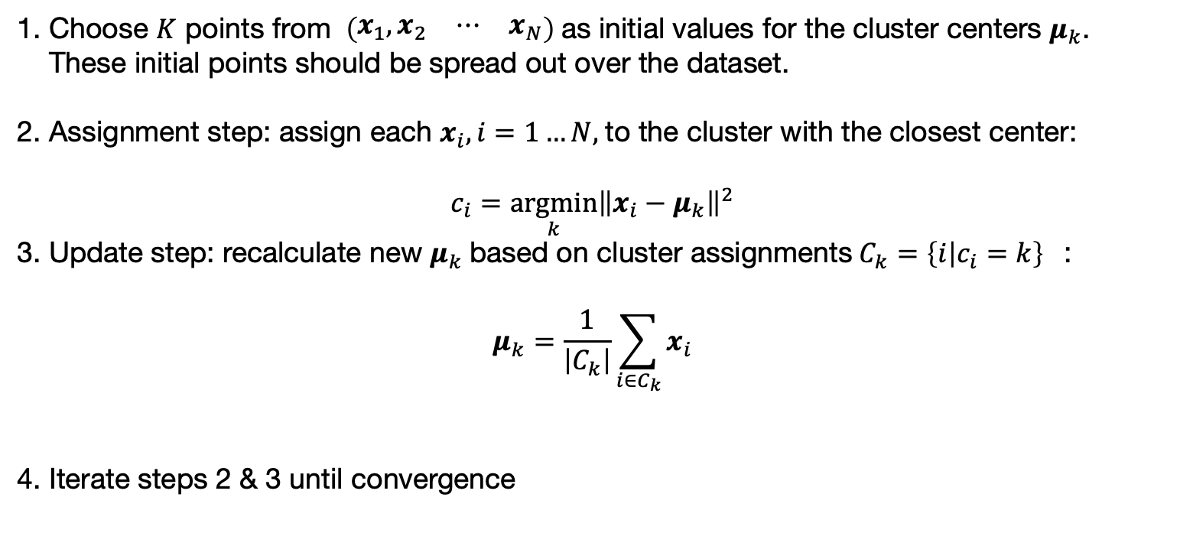
K-means Clustering
Choose $K$ points from $\left(\begin{matrix}x_{1},x_{2} & ⋯ & x_{N}\end{matrix}\right)$as initial values for the cluster centers $μ_{k}$. These initial points should be spread out over the dataset.
Assignment step: assign each $x_{i}, i=1…N,$to the cluster with the closest center: $c_{i}=\underset{k}{argmin}{{\left\|x_{i}−μ_{k}\right\|}^{2}}$
Update step: recalculate new $μ_{k}$based on cluster assignments ${C_{k}=\left\{i | c_{i}=k\right\}}_{}$: $μ_{k}=\frac{1}{\left|C_{k}\right|}\sum_{i∈C_{k}}{x_{i}}$
Iterate steps 2 & 3 until convergence
K-means at work

Slide 48



K-means
K-means initially assigns each point to one of two clusters.
The centers of each subgroup is calculated as the average position of all the points in that group.
Isabelle Dupanloup, BCF

Slide 49



K-means
All the points closest to the solid blue triangle are assigned to the corresponding cluster while those close to the solid green circle are assigned to the other cluster.
New cluster centers are calculated and each observation reassigned to the cluster of the nearest center.
Isabelle Dupanloup, BCF

Slide 50


K-means
The iterative process stops after a given number of iterations or when the assignment of data points to clusters isn’t changing.
Isabelle Dupanloup, BCF

Slide 51
K-means
Advantage: easy to implement and fast and efficient in terms of computational cost
Disadvantages:
Choice of K
Initial seeds have a strong impact on final results
Clustering data of varying sizes and density
Clustering outliers
Isabelle Dupanloup, BCF

Slide 52

K-means
Xiao et al. (2019) Precision Medicine and Imaging
Isabelle Dupanloup, BCF
Notes:
Purpose:
The tumor microenvironment has a profound impact on prognosis and immunotherapy. However, the landscape of the triple-negative breast cancer (TNBC) micro-environment has not been fully understood.
Experimental Design:
Using the largest original multi-omics dataset of TNBC (n=386), we conducted an extensive immunogenomic analysis to explore the heterogeneity and prognostic significance of the TNBC microenvironment. We further analyzed the potential immune escape mechanisms of TNBC.
Results:
The TNBC microenvironment phenotypes were classified into three heterogeneous clusters: cluster 1, the"immune-desert" cluster, with low microenvironment cell infiltration; cluster 2, the "innate immune-inactivated" cluster, with resting innate immune cells and nonimmune stromal cells infiltration; and cluster 3, the "immune-inflamed" cluster, with abundant adaptive and innate immune cells infiltration.
RNA-seq data (tumor tissues: n = 245; paired normal tissues: n = 90), HTA 2.0 microarray data (n = 141), whole-exome sequencing data (n = 268), OncoScan microarray copy-number data (n = 335), hematoxylin and eosin (H & E) sections data (n = 300), and tissue microarray data (n = 181)
We performed k-means (“kmeans” function in R) clustering and Nbclust testing (“NbClust” function in R, index = “all”) to determine the optimal number of stable TNBC microenvironment subtypes.

Slide 53



Gaussian Mixtures
Models $ℳ$
The data is modelled as a mixtures of $n$ Gaussian distributions: $p\left(x | π_{k},μ_{k},Σ_{k},k=1…K\right)=\sum_{k=1}^{K}{π_{k}𝒩\left(x | μ_{k},Σ_{k}\right)}$
The parameters $π_{k},μ_{k},Σ_{k}$ are determined by the EM algorithm:
Expectation step: calculate for each $x_{i}$ the probability $z_{ik}$to belong to cluster k $z_{ik}={π_{k}𝒩\left(x_{i} | μ_{k},Σ_{k}\right)}/{\sum_{k=1}^{K}{π_{k}𝒩\left(x_{i} | μ_{k},Σ_{k}\right)}}$
Maximization step: recalculate new $π_{k},μ_{k},Σ_{k}$ based on $z_{ik}$: ${n_{k}=\sum_{i=1}^{N}{z_{ik}}, π}_{k}=\frac{n_{k}}{N}, μ_{k}=\frac{1}{n_{k}}\sum_{i=1}^{N}{z_{ik}x_{i}},$ $Σ_{k}=ℳ\left(C_{ij}\right);C_{ij}=$ $\frac{1}{n_{k}}\sum_{i=1}^{N}{z_{ik}{\left(x_{i}−μ_{k}\right)}^{2}}$
Iterate steps 2 & 3 until convergence
$Z_{i}=\underset{k}{argmax}{z_{ik}}$: cluster assignement for $x_{i}$
Frailey & Raftery, The Computer Journal, 1998

Slide 54


Hierarchical clustering
2 types: agglomerative or divisive
Agglomerative:
Compute the proximity matrix
Let each data point be a cluster
Repeat: Merge the two closest clusters and update the proximity matrix
Until only a single cluster remains
Results can be visualized using a dendrogram
Isabelle Dupanloup, BCF

Slide 55

Hierarchical clustering
https://hbctraining.github.io/DGE_workshop_salmon/lessons/03_DGE_QC_analysis.html
Isabelle Dupanloup, BCF
Notes:
Hierarchical Clustering Heatmap
Similar to PCA, hierarchical clustering is another, complementary method for identifying strong patterns in a dataset and potential outliers. The heatmap displays the correlation of gene expression for all pairwise combinations of samples in the dataset. Since the majority of genes are not differentially expressed, samples generally have high correlations with each other (values higher than 0.80). Samples below 0.80 may indicate an outlier in your data and/or sample contamination.
The hierarchical tree can indicate which samples are more similar to each other based on the normalized gene expression values. The color blocks indicate substructure in the data, and you would expect to see your replicates cluster together as a block for each sample group. Additionally, we expect to see samples clustered similar to the groupings observed in a PCA plot.
In the plot below, we would be quite concerned about ‘Wt_3’ and ‘KO_3’ samples not clustering with the other replicates. We would want to explore the PCA to see if we see the same clustering of samples.

Slide 56

Agglomerative Hierarchical Clustering
Initialize clusters $C_{i}=\left\{x_{i}\right\}, i=1…N$, $id=\left\{1,2,…N\right\}$ and calculate distances $d_{ij}=d\left(C_{i},C_{j}\right)$
Merge closest clusters: $C_{i}=C_{i}∪$ $C_{j}$, if $d_{ij}=\min_{\left(l,k\right)}{d_{lk}}$ , drop $j:id=id∖j$ and recalculate $d_{ik}=d\left(C_{i},C_{k}\right), k∈id∖i$
Repeat 2 until $\left|id\right|=K$ or $d_{ik}≥ε, ∀i,k∈id$

Slide 57




Hierarchical clustering
1
Divisive: start with all the data points as a single cluster and in each iteration, we separate the data points from the cluster which are not similar
Similarity between clusters (choice of linkage)
Min
Max
Group Average
Distance Between Centroids
Ward’s Method (similar to Group Average)
2
3
4
Isabelle Dupanloup, BCF

Slide 58

Agglomerative Hierarchical Clustering
https://en.wikipedia.org/wiki/Hierarchical_clustering

Slide 59


DBSCAN
DBSCAN uses a minimal distance $ε$ and a minimal number of cluster seed points $n$ as input
It finds dense regions in the data and uses them as cluster seeds. Then it expands these clusters and adds points if they are within $ε$ distance to a cluster. All points not within reach of a cluster are marked as outliers.
DBSCAN can deal with clusters of arbitrary shapes.
DBSCAN requires clusters of similar density
Distance based clustering are difficult in high dimensions (curse of dimensionality)
Ester et al., Proc KDD, 1996

Slide 60

DBSCAN
sklearn docu

Slide 61

Supervised learning
Isabelle Dupanloup, BCF

Slide 62

Supervised learning
Isabelle Dupanloup, BCF

Slide 63

Supervised learning workflow
Isabelle Dupanloup, BCF
Notes:
What is Feature Extraction?
Feature extraction is a process of dimensionality reduction by which an initial set of raw data is reduced to more manageable groups for processing. A characteristic of these large data sets is a large number of variables that require a lot of computing resources to process. Feature extraction is the name for methods that select and /or combine variables into features, effectively reducing the amount of data that must be processed, while still accurately and completely describing the original data set.
Why is this Useful?
The process of feature extraction is useful when you need to reduce the number of resources needed for processing without losing important or relevant information. Feature extraction can also reduce the amount of redundant data for a given analysis. Also, the reduction of the data and the machine’s efforts in building variable combinations (features) facilitate the speed of learning and generalization steps in the machine learning process.
Practical Uses of Feature Extraction
Autoencoders– The purpose of autoencoders is unsupervised learning of efficient data coding. Feature extraction is used here to identify key features in the data for coding by learning from the coding of the original data set to derive new ones.
Bag-of-Words– A technique for natural language processing that extracts the words (features) used in a sentence, document, website, etc. and classifies them by frequency of use. This technique can also be applied to image processing.
Image Processing – Algorithms are used to detect features such as shaped, edges, or motion in a digital image or video.

Slide 64
Supervised learning datasets
Training dataset
The subset of the dataset provided to the algorithm for learning is called the training set.
Validation dataset
A set of examples used to tune the parameters of a classifier/regressor.
Hybrid dataset: it is training data used for testing, but neither as part of the low-level training nor as part of the final testing
Test dataset
A set of examples used only to assess the performance of a fully-specified classifier/regressor
Isabelle Dupanloup, BCF
Notes:
A validation dataset is a dataset of examples used to tune the hyperparameters (i.e. the architecture) of a classifier. It is sometimes also called the development set or the "dev set"^{[11]}. An example of a hyperparameter for artificial neural networks includes the number of hidden units in each layer.^{[7][8]} It, as well as the testing set (as mentioned above), should follow the same probability distribution as the training dataset.
In order to avoid overfitting, when any classification parameter needs to be adjusted, it is necessary to have a validation dataset in addition to the training and test datasets. For example, if the most suitable classifier for the problem is sought, the training dataset is used to train the different candidate classifiers, the validation dataset is used to compare their performances and decide which one to take and, finally, the test dataset is used to obtain the performance characteristics such as accuracy, sensitivity, specificity, F-measure, and so on. The validation dataset functions as a hybrid: it is training data used for testing, but neither as part of the low-level training nor as part of the final testing.
The basic process of using a validation dataset for model selection (as part of training dataset, validation dataset, and test dataset) is:^{[8][12]}
Since our goal is to find the network having the best performance on new data, the simplest approach to the comparison of different networks is to evaluate the error function using data which is independent of that used for training. Various networks are trained by minimization of an appropriate error function defined with respect to a training data set. The performance of the networks is then compared by evaluating the error function using an independent validation set, and the network having the smallest error with respect to the validation set is selected. This approach is called the hold out method. Since this procedure can itself lead to some overfitting to the validation set, the performance of the selected network should be confirmed by measuring its performance on a third independent set of data called a test set.
An application of this process is in early stopping, where the candidate models are successive iterations of the same network, and training stops when the error on the validation set grows, choosing the previous model (the one with minimum error).

Slide 65
Supervised learning
Supervised learning is where you have input variables (x) and an output variable (Y) and you use an algorithm to learn the mapping function from the input to the output.
Y = f(X)
The goal is to approximate the mapping function so well that when you have new input data (x) that you can predict the output variables (Y) for that data.
It is called supervised learning because the process of an algorithm learning from the training dataset can be thought of as a teacher supervising the learning process. We know the correct answers, the algorithm iteratively makes predictions on the training data and is corrected by the teacher. Learning stops when the algorithm achieves an acceptable level of performance
Isabelle Dupanloup, BCF

Slide 66
Supervised learning
Let’s assume our simple predictor has this form:
h(x) =θ₀ + θ₁x
where θ₀ and θ₁ are constants. Our goal is to find the perfect values of θ₀ and θ₁ to make our predictor work as well as possible.
Optimizing the predictor h(x) is done using training examples.
For each training example, we have an input value x_train, for which a corresponding output, y, is known in advance.
For each example, we find the difference between the known, correct value y, and our predicted value h(x_train).
With enough training examples, these differences give us a useful way to measure the “wrongness” of h(x).
We can then tweak h(x) by tweaking the values of θ₀ and θ₁ to make it “less wrong”.
This process is repeated over and over until the system has converged on the best values for θ₀ and θ₁
In this way, the predictor becomes trained, and is ready to do some real-world predicting.
Isabelle Dupanloup, BCF

Slide 67

Supervised learning
Fundamentally, classification is about predicting a label and regression is about predicting a quantity.
Classification predictive modeling is the task of approximating a mapping function (f) from input variables (X) to discrete output variables (y).
Regression predictive modeling is the task of approximating a mapping function (f) from input variables (X) to a continuous output variable (y).
Isabelle Dupanloup, BCF

Slide 68
Supervised learning
Supervised learning problems can be further grouped into regression and classification problems.
Classification: A classification problem is when the output variable is a category, such as “red” or “blue” or “disease” and “no disease”
Regression: A regression problem is when the output variable is a real value, such as “dollars” or “weight”
Some popular examples of supervised machine learning algorithms are:
Linear regression for regression problems
Random forest for classification and regression problems
Support vector machines for classification problems
Isabelle Dupanloup, BCF

Slide 69

Supervised learning
Consider the following training data, wherein company employees have rated their satisfaction on a scale of 1 to 100:
First, notice that the data is a little noisy.
That is, while we can see that there is a pattern to it (i.e. employee satisfaction tends to go up as salary goes up), it does not all fit neatly on a straight line.
This will always be the case with real-world data (and we absolutely want to train our machine using real-world data!).
So then how can we train a machine to perfectly predict an employee’s level of satisfaction?
The answer, of course, is that we can’t.
The goal of ML is never to make “perfect” guesses, because ML deals in domains where there is no such thing.
The goal is to make guesses that are good enough to be useful.
Isabelle Dupanloup, BCF

Slide 70

Supervised learning datasets
Train-test-validation split ratio
Isabelle Dupanloup, BCF
Notes:
There are two competing concerns: with less training data, your parameter estimates have greater variance. With less testing data, your performance statistic will have greater variance. Broadly speaking you should be concerned with dividing data such that neither variance is too high, which is more to do with the absolute number of instances in each category rather than the percentage.
If you have a total of 100 instances, you're probably stuck with cross validation as no single split is going to give you satisfactory variance in your estimates. If you have 100,000 instances, it doesn't really matter whether you choose an 80:20 split or a 90:10 split (indeed you may choose to use less training data if your method is particularly computationally intensive).
Assuming you have enough data to do proper held-out test data (rather than cross-validation), the following is an instructive way to get a handle on variances:
Split your data into training and testing (80/20 is indeed a good starting point)
Split the training data into training and validation (again, 80/20 is a fair split).
Subsample random selections of your training data, train the classifier with this, and record the performance on the validation set
Try a series of runs with different amounts of training data: randomly sample 20% of it, say, 10 times and observe performance on the validation data, then do the same with 40%, 60%, 80%. You should see both greater performance with more data, but also lower variance across the different random samples
To get a handle on variance due to the size of test data, perform the same procedure in reverse. Train on all of your training data, then randomly sample a percentage of your validation data a number of times, and observe performance. You should now find that the mean performance on small samples of your validation data is roughly the same as the performance on all the validation data, but the variance is much higher with smaller numbers of test samples

Slide 71

Supervised learning datasets
K-fold cross validation
Isabelle Dupanloup, BCF

Slide 72

Assessing performance
confusion matrix
TP (True Positives): number of positive predictions which are correct
FP (False Positives): number of positive predictions which are incorrect
TN (True Negatives): number of negative predictions which are correct
FN (False Negatives): number of negative predictions which are incorrect
LABEL / PREDICTED | P | N
P | TP | FN
N | FP | TN
Isabelle Dupanloup, BCF
Notes:
Most of the time, the number of False Positives and False Negatives (i.e., the errors that we would like to minimise) is not fixed, but depends on a continuous score (e.g. probability returned by the forward algorithm) on which we set a threshold.
Changing this threshold will change the number of errors; a higher threshold (i.e. a more stringent criteria for classifying an observation as “positive”) will usually result in a lower number of False Positives, but a higher number of False Negatives.

Slide 73






Assessing performance
$$\frac{TP}{TP+FP}$$
Precision: fraction of the positive predictions that are actually positive:
Specificity: fraction of the negative predictions that are correctly identified:
Recall / TPR: fraction of the positive predictions that are correctly identified:
FPR: 1 – Precision =
F-measure: harmonic mean of precision and recall:
Accuracy: fraction of the total predictions that are correctly identified:
Total of positive predictions
$$\frac{TN}{TN+FP}$$
Total of negative labels
$$\frac{TP}{TP+FN}$$
Total of positive labels
Sensitivity
$$\frac{FP}{TN+FP}$$
Total of negative labels
$$2∗\frac{precision ∗recall}{precision+recall}$$
$$\frac{TP+TN}{TN+TN+FP+FN}$$
Isabelle Dupanloup, BCF

Slide 74

Assessing performance: AUC - ROC curve
ROC = Receiver Operating Characteristic
AUC = Area Under the Curve
AUC - ROC curve is a performance measurement for the classification problems at various threshold settings
ROC is a probability curve and AUC represents the degree or measure of separability. It tells how much the model is capable of distinguishing between classes. Higher the AUC, the better the model is at predicting 0s as 0s and 1s as 1s. By analogy, the higher the AUC, the better the model is at distinguishing between patients with the disease and no disease.
Isabelle Dupanloup, BCF

Slide 75



Assessing performance: AUC - ROC curve
Moving the Threshold: right
Moving the Threshold: left
Isabelle Dupanloup, BCF

Slide 76




Assessing performance: AUC - ROC curve
Isabelle Dupanloup, BCF
Notes:
AUC - ROC curve is a performance measurement for the classification problems at various threshold settings. ROC is a probability curve and AUC represents the degree or measure of separability. It tells how much the model is capable of distinguishing between classes. Higher the AUC, the better the model is at predicting 0s as 0s and 1s as 1s. By analogy, the Higher the AUC, the better the model is at distinguishing between patients with the disease and no disease.

Slide 77

Some Notations:
M features
$$X={\left(\begin{matrix}x_{1},x_{2} & ⋯ & x_{N}\end{matrix}\right)}^{T}=\left(\begin{matrix}x_{11} & ⋯ & x_{1M} \\ ⋮ & ⋱ & ⋮ \\ x_{N1} & ⋯ & x_{NM}\end{matrix}\right)$$
Data matrix:
N items
Outcome:
$$y={\left(y_{1},…,y_{N}\right)}^{T}$$
Outcome is a known attribute of the cases (rows). It can be a factor
(e.g. healthy/diseased), a multiclass label (e.g. protein function) or
a continuous variable (e.g. survival time).

Slide 78

Some More Notations:
In the classification task, we would like to predict the outcome $y$ from the features $X$.
We choose a classifier $𝒞_{φ}$ with hyper parameters $φ$ and internal parameters $θ$.
Hyper parameters (e.g $k$ in $k−NN$, kernel in $SVM$, learning rate in $LR$) have to be specified by the user or learned in CV loop outside the classifier.
The internal parameters $θ$ are learned by the classifier (e.g. the coefficients in $LR$, or support vector coefficients in $SVM$).
The classifier learns those internal parameters $θ$ that are able to predict $y$ from the features $X$ with the lowest error: $θ=\underset{θ}{argmin}{ℒ\left(𝒞_{φ}\left(X,θ\right),y\right)}$ where the loss function $ℒ$ measures the error between predicted ($𝒞_{φ}\left(X,θ\right)$) and known ($y$) outcomes.

Slide 79
Which Classifier Should We Choose?
There is a mathematical theorem that says that there is no universally best classifier. It really depends on the data!
One needs to test several classifiers for each dataset and compare the results.
Best is to have a few favorite classifiers (e.g. kNN, LR, SVM), which you know well, and which are somehow complementary (local density based, linear, or inbetween)

Slide 80

Which Classifier Should We Choose?
sklearn classfier comparison

Slide 81
Training, Validation and Test Sets
Given a dataset, we can always find a classifier that perfectly predicts the outcome (for example the 1-NN classifier) for this dataset.
However, the purpose of training a classifier is to give us accurate predictions on a new and independent test dataset. The performance on the training data may be too optimistic and cannot be reproduced on the test data. We call this “overfitting the training data”.
When choosing a classifier, we will always select the one that performs best on the test or validation data.

Slide 82

Training, Validation and Test Sets
sklearn GridSearchCV

Slide 83
Bias versus Variance Tradeoff
All classifiers make errors and wrongly predict class labels for certain instances. The error can be split into two part: bias and variance.
Variance: the classifier will depend on the subset of the data we choose for training. The more a classifier depends on the training data selection, the higher its variance.
Bias: the variance usually decreases with the size of the training set. However, even for very large training sets, there will be an error left due to the bias of the classifier. For example, a linear classifier will never be perfectly able to separate classes with non-linear boundaries even if large datasets are available.
Classifiers with low bias fit the training data well, but may have a large variance and low performance on the test set. Others have a larger bias, but are more stable and predictive for the test set.

Slide 84



Bias versus Variance Tradeoff
Linear SVM
Regularized Logistic Regr.
1-NN
RBF SVM
Linear
Perceptron
Deep learning
https://en.wikipedia.org/wiki/Bias-variance_tradeoff

Slide 85


K-Nearest Neighbor Classifier
The k-Nearest neighbor (k-NN) classifier is probably the simplest non-trivial classifier. Given a training dataset${ X}^{train},{ y}^{train}$ we predict the class of an instance $x$ by taking the $k$ nearest instances $x_{i}^{train},i∈kNN\left(x\right)$according to some distance metric $d\left(x,x_{i}^{train}\right)$ and predict the majority class in $y_{i}^{train},i∈kNN\left(x\right)$
Instead of simply predicting the majority class we can also weight the classes by $1/{d\left(x, x_{i}^{train}\right)}$.
The number of neighbors $k$ we will determine with cross validation.
https://en.wikipedia.org/wiki/K-nearest_neighbors_algorithm

Slide 86
k-Nearest Neighbors (KNN)
Pros
Training phase much faster compared to other classification algorithms
No need to train a model for generalization
Can be useful in case of nonlinear data
Can be used for regression: the output value for the object is computed by the average of k closest neighbors value.
Cons
Testing phase is slower and costlier in terms of time and memory
It requires large memory for storing the entire training dataset for prediction
It requires scaling of data because KNN uses the Euclidean distance between two data points to find nearest neighbors. Euclidean distance is sensitive to magnitudes. The features with high magnitudes will weight more than features with low magnitudes
It is not suitable for large dimensional data.
Isabelle Dupanloup, BCF
Notes:
Pros
The training phase of K-nearest neighbor classification is much faster compared to other classification algorithms. There is no need to train a model for generalization, That is why KNN is known as the simple and instance-based learning algorithm. KNN can be useful in case of nonlinear data. It can be used with the regression problem. Output value for the object is computed by the average of k closest neighbors value.
Cons
The testing phase of K-nearest neighbor classification is slower and costlier in terms of time and memory. It requires large memory for storing the entire training dataset for prediction. KNN requires scaling of data because KNN uses the Euclidean distance between two data points to find nearest neighbors. Euclidean distance is sensitive to magnitudes. The features with high magnitudes will weight more than features with low magnitudes. KNN also not suitable for large dimensional data.

Slide 87

k-Nearest Neighbors (KNN)
https://scrnaseq-course.cog.sanger.ac.uk/
Isabelle Dupanloup, BCF
Notes:
Seurat now includes an graph-based clustering approach compared to (Macosko et al.). Importantly, the distance metric which drives the clustering analysis (based on previously identified PCs) remains the same. However, our approach to partioning the cellular distance matrix into clusters has dramatically improved. Our approach was heavily inspired by recent manuscripts which applied graph-based clustering approaches to scRNA-seq data SNN-Cliq, Xu and Su, Bioinformatics, 2015 and CyTOF data PhenoGraph, Levine et al., Cell, 2015. Briefly, these methods embed cells in a graph structure - for example a K-nearest neighbor (KNN) graph, with edges drawn between cells with similar gene expression patterns, and then attempt to partition this graph into highly interconnected ‘quasi-cliques’ or ‘communities’. As in PhenoGraph, we first construct a KNN graph based on the euclidean distance in PCA space, and refine the edge weights between any two cells based on the shared overlap in their local neighborhoods (Jaccard similarity). To cluster the cells, we apply modularity optimization techniques such as the Louvain algorithm (default) or SLM SLM, Blondel et al., Journal of Statistical Mechanics, to iteratively group cells together, with the goal of optimizing the standard modularity function.

Slide 88




Logistic Regression
In logistic regression we assume that our data is linearly separable by a hyperplane ${h=w_{0}+\sum_{i=1}^{M}{w_{i}x_{i}}=w}_{0}+w∙$ $x=0$.
We assume a sigmoid shaped class probability distribution $p$, which only depends on the distance $d$ to $h∶d=\frac{w_{0}+w∙ x}{\left\|w\right\|}$

Slide 89

Logistic Regression
$p\left(x | y=1\right)=\frac{1}{1+e^{−\left(w_{0}+w∙ x\right)}}⟺\log{\frac{p}{1−p}=}$ $w_{0}+w∙ x$
$p\left(x | y=0\right)=1−$ $p\left(x | y=1\right)$
Loss functions:
$$ℒ\left(w_{0},w, X\text{, }\text{y} \right)=−\frac{1}{N}\left\{\sum_{i,y_{i}=1}{\log{p\left(x_{i} | y=1\right)}+\sum_{i,y_{i}=0}{\log{p\left(x_{i} | y=0\right)}}}\right\}$$
Regularization: keep $w$ small and boundary smooth:
$ℒ\left(w_{0},w, X\text{, }\text{y} \right)+\frac{1}{C}\sum_{i=1}^{N}{\left|w_{i}\right|}$ : lasso or ‘l1’
$ℒ\left(w_{0},w, X\text{, }\text{y} \right)+\frac{1}{C}\sum_{i=1}^{N}{w_{i}^{2}}$ : ridge or ‘l2’
$ℒ\left(w_{0},w, X\text{, }\text{y} \right)+\frac{1}{C}\sum_{i=1}^{N}{{α\left|w_{i}\right|+\left(1−α\right)w}_{i}^{2}}$ : elasticnet

Slide 90


Logistic Regression
C=10
C=0.005
In high dimension with many noisy features the effect of regularization is more important

Slide 91



Multinomial Logistic Regression ($K$ classes)
$p\left(x | y=k\right)=\frac{e^{w_{0k}+w_{k}∙x}}{\sum_{i=1}^{K}{e^{w_{0i}+w_{i}∙x}}}$
Class $y\left(x\right)=\underset{k}{argmax}{p\left(x | y=k\right)}=$ $\underset{k}{argmax}\left(w_{0k}+w_{k}∙x \right)$
Loss function:
$$ℒ\left(w_{0k},w_{k}, X\text{, }\text{y} \right)=−\frac{1}{N}\sum_{i=1}^{N}{\sum_{k=1}^{K}{y_{i}^{k}}}\log{p\left(x_{i} | y=k\right)};$$
$$y_{i}^{k}=\left\{\begin{matrix}1:y\left(x_{i}\right)=k \\ 0:y\left(x_{i}\right)≠k\end{matrix}\right.$$

Slide 92


Logistic regression
Torang et al. (2019) BMC Bioinformatics 20(1):433.
Isabelle Dupanloup, BCF
Notes:
Arezo Torang, Paraag Gupta & David J. Klinke II
BMC Bioinformatics volume 20, Article number: 433 (2019)
Abstract
Background
Host immune response is coordinated by a variety of different specialized cell types that vary in time and location. While host immune response can be studied using conventional low-dimensional approaches, advances in transcriptomics analysis may provide a less biased view. Yet, leveraging transcriptomics data to identify immune cell subtypes presents challenges for extracting informative gene signatures hidden within a high dimensional transcriptomics space characterized by low sample numbers with noisy and missing values. To address these challenges, we explore using machine learning methods to select gene subsets and estimate gene coefficients simultaneously.
Results
Elastic-net logistic regression, a type of machine learning, was used to construct separate classifiers for ten different types of immune cell and for five T helper cell subsets. The resulting classifiers were then used to develop gene signatures that best discriminate among immune cell types and T helper cell subsets using RNA-seq datasets. We validated the approach using single-cell RNA-seq (scRNA-seq) datasets, which gave consistent results. In addition, we classified cell types that were previously unannotated. Finally, we benchmarked the proposed gene signatures against other existing gene signatures.
Conclusions
Developed classifiers can be used as priors in predicting the extent and functional orientation of the host immune response in diseases, such as cancer, where transcriptomic profiling of bulk tissue samples and single cells are routinely employed. Information that can provide insight into the mechanistic basis of disease and therapeutic response. The source code and documentation are available through GitHub: https://github.com/KlinkeLab/ImmClass2019.

Slide 93
Support Vector Machines (SVM)
Separating hyperplanes
Soft margin classification
Linear SVM
Non-linear SVM & Kernels

Slide 94


Largest Margin Separating Hyperplane
Hyperplanes are linear decision boundaries that help classify the data points.
Objective:
find a hyperplane in an M-dimensional space (M = number of features) that distinctly classifies the data points
find a plane that has the maximum margin, i.e the maximum distance between data points of both classes
Maximizing the margin distance provides some reinforcement so that future data points can be classified with more confidence
Isabelle Dupanloup, BCF

Slide 95





Support Vector Machines (SVM)
Scenario 1
Scenario 2
Scenario 3
Scenario 4
Notes:
Identify the right hyper-plane (Scenario-1): Here, we have three hyper-planes (A, B and C). Now, identify the right hyper-plane to classify star and circle. You need to remember a thumb rule to identify the right hyper-plane: “Select the hyper-plane which segregates the two classes better”. In this scenario, hyper-plane “B” has excellently performed this job.
Identify the right hyper-plane (Scenario-2): Here, we have three hyper-planes (A, B and C) and all are segregating the classes well. Now, How can we identify the right hyper-plane? Here, maximizing the distances between nearest data point (either class) and hyper-plane will help us to decide the right hyper-plane. This distance is called as Margin. Let’s look at the below snapshot: Above, you can see that the margin for hyper-plane C is high as compared to both A and B. Hence, we name the right hyper-plane as C. Another lightning reason for selecting the hyper-plane with higher margin is robustness. If we select a hyper-plane having low margin then there is high chance of miss-classification.
Identify the right hyper-plane (Scenario-3): Hint: Use the rules as discussed in previous section to identify the right hyper-plane
Some of you may have selected the hyper-plane B as it has higher margin compared to A. But, here is the catch, SVM selects the hyper-plane which classifies the classes accurately prior to maximizing margin. Here, hyper-plane B has a classification error and A has classified all correctly. Therefore, the right hyper-plane is A.
Can we classify two classes (Scenario-4): Below, I am unable to segregate the two classes using a straight line, as one of the stars lies in the territory of other(circle) class as an outlier. As I have already mentioned, one star at other end is like an outlier for star class. The SVM algorithm has a feature to ignore outliers and find the hyper-plane that has the maximum margin. Hence, we can say, SVM classification is robust to outliers.

Slide 96




Largest Margin Separating Hyperplane
https://en.wikipedia.org/wiki/Support-vector_machine
$$y_{i}=1$$
Margin $m=\frac{2}{\left\|w\right\|}$
Maximal margin $m⟹$minimal$\left\|w\right\|$
$\min_{w,b}{{\left\|w\right\|}^{2}}$ subject to $y_{i}\left(w∙x_{i}−b\right)≥1, i=1..N$
$$y_{i}=−1$$

Slide 97






Soft Margin Separating Hyperplane
$ζ_{i}=\max_{}\left(0, 1−y_{i}\left(w∙x_{i}−b\right)\right)$
$\min_{w}\left\{{\left\|w\right\|}^{2}+C\sum_{i=1}^{N}{ζ_{i}}\right\}$ subject to $y_{i}\left(w∙x_{i}−b\right)≥1−ζ_{i},ζ_{i}≥0$ $i=1…N$
This is a quadratic programming problem. Efficient algorithms implemented in sklearn LinearSVC can solve this in $O\left(NM\right)$
Non-linear SVM (see below) requires $O\left(N^{α}M\right)$, where $2<α<3$
$$y_{i}=1$$
$$ζ_{k}$$
$$ζ_{j}$$
$$y_{i}=0$$
$$ζ_{i}$$

Slide 98


Non-Linear Support Vector Machines
Dual form: $\min_{α}\left\{−\frac{1}{2}\sum_{i=1}^{N}{\sum_{j=1}^{N}{α_{i}α_{j}y_{i}y_{j}{ x}_{i}∙x_{j}+\sum_{i=1}^{N}{α_{i}}}}\right\}$ subject to: $\sum_{i=1}^{N}{y_{i}α_{i}=0 \text{and} }{0≤α}_{i}≤C,i=1…N$.
$w=\sum_{i=1}^{N}{α_{i}y_{i}x_{i}}$; $S=\left\{i | α_{i}>0\right\}; b=\frac{1}{\left|S\right|}\sum_{i∈S}{\left(y_{i}−w∙x_{i}\right)}$
Prediction: $f\left(x\right)=$ $w∙x−b=$ $\sum_{i=1}^{N}{α_{i}y_{i}x_{i}x}−b$
Kernel trick: $x∙y↦K\left(x,y\right)$
Boser, Guyon & Vapnik, Proc. 5th COLT, 1992

Slide 99

Non-Linear Support Vector Machines
Kernel trick: $x∙y↦K\left(x,y\right)$
$K\left(x,y\right)=K\left(y,x\right);cK\left(x_{i},x_{j}\right)c^{T}≥0,∀c∈ℝ^{n}, x_{i},i=1…n∈ℝ^{m}$
Linear: $K\left(x,y\right)=$ $x∙y$
Polynomial:$K\left(x,y\right)={\left(γx∙y+r\right)}^{d}$
Radial: $K\left(x,y\right)=e^{−γ{\left\|x−y\right\|}^{2}}$
Sigmoid: $K\left(x,y\right)=\tanh\left(γx∙y+r\right)$

Slide 100
Support vector machines (SVM)
Hyperparameters
Type of kernel (linear, polynomial, RBF; etc.)
Parameters of the kernel
Type of regularization
λ: regularization strength

Slide 101



Radial Basis Kernel
low variance
$$C$$
low bias
low variance
low bias
sklearn SVC radial basis

Slide 102

Kernels
The beauty of SVM’s or other kernel based approaches is that one does not need the data matrix $X={\left(\begin{matrix}x_{1},x_{2} & ⋯ & x_{N}\end{matrix}\right)}^{T}$ explicitely, but only the relation between the data points $x_{i}$given by the kernel $K_{ij}=K\left(x_{i},x_{j}\right)$
This can be advantage when dealing with data items that cannot trivially be tranformed to vectors, but for which similarity kernels exist.
For example, if $x_{i}$are sequences, then $K\left(x_{i},x_{j}\right)$ can be defined by a sequence similarity score, without the need to turn sequences into vectors.

Slide 103

String Kernels (not included in sklearn.svm)
Example of string kernel from Hilmarsson et al. BioRxiv, 2021

Slide 104


Support Vector Regression (SVR)
$$\min_{w}\left\{{\left\|w\right\|}^{2}+C\sum_{i=1}^{N}{\left(ζ_{i}+ζ_{i}^{∗}\right)}\right\}$$ subject to $\left\{\begin{matrix}y_{i}−w∙x_{i}−b≤ε+ζ_{i} \\ w∙x_{i}+b−y_{i}≤ε+ζ_{i}^{∗} \\ ζ_{i},ζ_{i}^{∗}≥0\end{matrix}\right.,$ $i=1…N$
For dual form and kernel trick see Smola & Schölkopf, Statistics and Computing, 2004

Slide 105

Multiclass Classification
If more than two classes there are several options to deal with them:
Ovo (one-versus-one): split the problem into ${K\left(K−1\right)}/2$ classification tasks. At prediction time we choose the class with the most votes. Implemented in SVC. See also sklearn OneVsOneClassifier.
Ovr (one-versus-rest): split the problem into $K$ classification tasks. At prediction time we choose the class with the highest prediction score. Implemented in LogisticRegression. See also OneVsRestClassifier.
Inherently multiclass: Some classifiers have inherent support for multiclass problems (e.g. k-NN, LogisticRegression, DecisionTree, RandomForest)
Check: https://scikit-learn.org/stable/modules/multiclass.html

Slide 106


Multiclass Classification
ovr
multinomial

Slide 107

Support vector machines (SVM)
Baek et al. (2020) Ultrasound Med Biol 46(12):3379-3392.
Notes:
Scattering Signatures of Normal versus Abnormal Livers with Support Vector Machine Classification
Jihye Baek ¹ , Sedigheh S Poul ² , Terri A Swanson ³ , Theresa Tuthill ³ , Kevin J Parker ⁴
Ultrasound Med Biol 2020 Dec;46(12):3379-3392.
DOI: 10.1016/j.ultrasmedbio.2020.08.009
Abstract
Fifty years of research on the nature of backscatter from tissues has resulted in a number of promising diagnostic parameters. We recently introduced two analyses tied directly to the biophysics of ultrasound scattering: the H-scan, based on a matched filter approach to distinguishing scattering transfer functions, and the Burr distribution for quantification of speckle patterns. Together, these analyses can produce at least five parameters that are directly linked to the mathematics of ultrasound in tissue. These have been measured in vivo in 35 rat livers under normal conditions and after exposure to compounds that induce inflammation, fibrosis, and steatosis in varying combinations. A classification technique, the support vector machine, is employed to determine clusters of the five parameters that are signatures of the different liver conditions. With the multiparametric measurement approach and determination of clusters, the different types of liver pathology can be discriminated with 94.6% accuracy.

Slide 108


Unbalanced Classes
Very often in ML, there are different number of instances in each class
This can be a problem for a ML classification method if classes are well mixed
If ‘accuracy’ is used in a CV loop a classifier will try to predict the abundant class correctly, and ignore the rare class.
Solution: Use ‘roc_auc’ or work with ‘class_weight’ parameter.
class_weight=‘balanced’ : ${cw}_{k}=\frac{N}{K∙\sum_{i=1}^{N}{y_{i}^{k}}}$
Set ‘class_weight’ or learn in CV loop

Slide 109


Decision trees
Supervised learning technique that can be used for both classification and Regression problems, but mostly it is preferred for solving Classification problems
Tree-structured classifier, where internal nodes represent the features of a dataset, branches represent the decision rules and each leaf node represents the outcome.
Isabelle Dupanloup, BCF

Slide 110



Decision trees
Algorithm:
hierarchical sequence of questions on your features that can be answered by yes or no and that subdivides the data into subgroups on which a new question is asked, and so on and so on
tests all the features and chooses the most discriminative feature (in terms of the labels) to divide the data into subsets (impurity: Shannon entropy, Gini entropy)
Features:
Color: blue or red
Shape: square or circle
Those groups are highly skewed toward certain class
Those groups are well mixed
Isabelle Dupanloup, BCF

Slide 111

Decision trees
Isabelle Dupanloup, BCF

Slide 112


Decision trees
Hyperparameters:
Criterion: function to measure the quality of a split
Max Tree depth: maximum depth of your model. Maximum depth refers to the length of the longest path from a root to a leaf
Min Splitting of nodes: minimum number of samples (i.e. training inputs) required to split an internal node
Min Splitting of leaves: minimum number of samples (i.e. training inputs) required to be at a leaf node
Maximum number of features to consider when looking for the best split: the search for a split does not stop until at least one valid partition of the node samples is found, even if it requires to effectively inspect more than max_features features.
Isabelle Dupanloup, BCF

Slide 113
Random forest
popular machine learning algorithm which can be used for both Classification and Regression problems in ML
based on the concept of ensemble learning, which is a process of combining multiple classifiers to solve a complex problem and to improve the performance of the model.
Random Forest is a classifier that contains a number of decision trees on various subsets of the given dataset and takes the average to improve the predictive accuracy of that dataset.
Instead of relying on one decision tree, the random forest takes the prediction from each tree and based on the majority votes of predictions, and it predicts the final output.
The greater number of trees in the forest leads to higher accuracy and prevents the problem of overfitting.
Isabelle Dupanloup, BCF

Slide 114

Random forest
Bootstrap (select the features and the training samples at random, with replacement, to create the n training datasets)
Hyperparameters:
Same as for the decision trees
Number of trees in the forest
Isabelle Dupanloup, BCF

Slide 115

Random forest
Isabelle Dupanloup, BCF

Slide 116
Adaptive Boosting (AdaBoost)
AdaBoost algorithms can be used for both classification and regression problem
Combine multiple “weak classifiers” into a single “strong classifier”
Based on the concept of ensemble learning: power of ensembling is such that we can still build powerful ensemble models even when the individual models in the ensembles are extremely simple.
Boosting algorithms try to build a strong learner (predictive model) from the mistakes of several weaker models.
Boosting basically tries to reduce the bias error which arises when models are not able to identify relevant trends in the data. This happens by evaluating the difference between the predicted value and the actual value.
You start by creating a model from the training data. Then, you create a second model from the previous one by trying to reduce the errors from the previous model. Models are added sequentially, each correcting its predecessor, until the training data is predicted perfectly or the maximum number of models have been added.
Isabelle Dupanloup, BCF

Slide 117
Adaptive Boosting (AdaBoost)
The weak learners in AdaBoost are decision trees with a single split, called decision stumps.
Stumps alone are not a good way to make decisions. A full-grown tree combines the decisions from all variables to predict the target value. A stump, on the other hand, can only use one variable to make a decision
Difference between Random Forest and AdaBoost:
AdaBoost uses a forest of stumps rather than trees.
AdaBoost stumps have different contributions to the prediction.
In AdaBoost, models are added sequentially, each correcting its predecessor.
Each stump is made by taking the mistakes of the previous stumps into account by applying an importance weight on each sample. At the beginning of the algorithm, all the samples have the same weight but then after the first stump, the missclassified points will have a higher weight so that the next stumps really focuses on predicting them well.
Isabelle Dupanloup, BCF

Slide 118
Adaptive Boosting (AdaBoost)
A weak classifier (e.g. a decision stump) is made on top of the training data based on the weighted samples. Here, the weights of each sample indicate how important it is to be correctly classified. Initially, for the first stump, we give all the samples equal weights.
We create a decision stump for each variable and see how well each stump classifies samples to their target classes.
More weight is assigned to the incorrectly classified samples so that they're classified correctly in the next decision stump. Weight is also assigned to each classifier based on the accuracy of the classifier, which means high accuracy = high weight !
Reiterate from Step 2 until all the data points have been correctly classified, or the maximum iteration level has been reached.
Isabelle Dupanloup, BCF

Slide 119

Adaptive Boosting (AdaBoost)
Misclassification rate is calculated for each model:
$∝ = L∗ln⁡(\frac{1−error}{error}$) with L = learning rate and error = $\frac{\text{sum}\text{(}\text{w}\text{(}\text{i}\text{) ∗ }\text{terror}\text{(}\text{i}\text{))}}{\text{sum}\text{(}\text{w}\text{(}\text{i}\text{))} }$
Predictions are made by calculating the weighted average of the weak classifiers.
Hyperparameters:
Number of stumps
Learning rate L: weight applied to each classifier at each boosting iteration
Need high quality data !
Isabelle Dupanloup, BCF

Slide 120

Adaptive Boosting (AdaBoost)
Isabelle Dupanloup, BCF

Slide 121

Adaptive Boosting (AdaBoost)
Isabelle Dupanloup, BCF

Slide 122

Adaptive Boosting (AdaBoost)
Isabelle Dupanloup, BCF

Slide 123
Gradient Boosting
Another boosting model. Remember, boosting model’s key is learning from the previous mistakes.
Can be used for both classification and regression problem
Gradient boosting involves three elements:
A loss function to be optimized.
A weak learner to make predictions: decision trees (with 4-to-8 levels)
An additive model to add weak learners to minimize the loss function:
Trees are added one at a time, and existing trees in the model are not changed.
A gradient descent procedure is used to minimize the loss when adding trees.
Isabelle Dupanloup, BCF
Notes:
While the AdaBoost model identifies the shortcomings by using high weight data points, gradient boosting performs the same by using gradients in the loss function (y=ax+b+e , e needs a special mention as it is the error term). The loss function is a measure indicating how good are model’s coefficients are at fitting the underlying data. A logical understanding of loss function would depend on what we are trying to optimise. For example, if we are trying to predict the sales prices by using a regression, then the loss function would be based off the error between true and predicted house prices. Similarly, if our goal is to classify credit defaults, then the loss function would be a measure of how good our predictive model is at classifying bad loans. One of the biggest motivations of using gradient boosting is that it allows one to optimise a user specified cost function, instead of a loss function that usually offers less control and does not essentially correspond with real world applications.

Slide 124

Gradient Boosting
Isabelle Dupanloup, BCF

Slide 125

Gradient Boosting
Prediction for sample i: 0.2
Prediction for sample i: 0.6
Learning rate = 1 Prediction for sample i: 0.2+1*0.6=0.8
Learning rate = 0.1 Prediction for sample i: 0.2+0.1*0.6=0.26
Isabelle Dupanloup, BCF

Slide 126
Gradient Boosting
The intuition behind gradient boosting algorithm is to repetitively leverage the patterns in residuals and strengthen a model with weak predictions and make it better
Once we reach a stage that residuals do not have any pattern that could be modeled, we can stop modeling residuals (otherwise it might lead to overfitting). Algorithmically, we are minimizing our loss function, such that test loss reach its minima.
Isabelle Dupanloup, BCF

Slide 127

Gradient Boosting
The ensemble consists of N trees. Tree1 is trained using the feature matrix X and the labels y. The predictions labelled y1(hat) are used to determine the training set residual errors r1. Tree2 is then trained using the feature matrix X and the residual errors r1 of Tree1 as labels. The predicted results r1(hat) are then used to determine the residual r2. The process is repeated until all the N trees forming the ensemble are trained.
Isabelle Dupanloup, BCF

Slide 128
Gradient Boosting
Gradient boosting is a greedy algorithm and can overfit a training dataset quickly.
It can benefit from regularization methods that penalize various parts of the algorithm and generally improve the performance of the algorithm by reducing overfitting.
Enhancements to basic gradient boosting:
Tree Constraints (small number of trees, short trees)
Shrinkage (learning rate)
Random sampling (bootstrap the training dataset)
Hyperparameters:
Loss function: deviance (= in logistic regression) or exponential (= in AdaBoost)
Learning rate: shrinks the contribution of each tree
Number of trees, trees length, minimum number of samples required to split an internal node, minimum number of samples required to be at a leaf node
Number of features to consider when looking for the best split, etc.
Isabelle Dupanloup, BCF
Notes:
The predictions of each tree are added together sequentially.
The contribution of each tree to this sum can be weighted to slow down the learning by the algorithm. This weighting is called a shrinkage or a learning rate.
Each update is simply scaled by the value of the “learning rate parameter v”
The effect is that learning is slowed down, in turn require more trees to be added to the model, in turn taking longer to train, providing a configuration trade-off between the number of trees and learning rate.
Decreasing the value of v [the learning rate] increases the best value for M [the number of trees].
It is common to have small values in the range of 0.1 to 0.3, as well as values less than 0.1.

Slide 129

Naive Bayes
classification technique based on Bayes’ Theorem with an assumption of independence among predictors (= features)
a classification problem may have k class labels y1, y2, …, yk and n input variables, X1, X2, …, Xn. We can calculate the conditional probability for a class label with a given instance or set of input values for each column x1, x2, …, xn as follows: P(yi | x1, x2, …, xn)
The conditional probability can then be calculated for each class label in the problem and the label with the highest probability can be returned as the most likely classification.
P(yi | x1, x2, …, xn) = P(x1, x2, …, xn | yi) * P(yi) / P(x1, x2, …, xn)
Independence between features
P(x1|yi) * P(x2|yi) * … P(xn|yi)
prior P(yi) easy to estimate from the data
constant used in calculating the conditional probability of each class for a given instance
estimated from the data
Isabelle Dupanloup, BCF

Slide 130
Naive Bayes
Advantages:
very easy to build and particularly useful for very large data sets.
outperform even highly sophisticated classification methods.
a good choice when CPU and memory resources are a limiting factor.
a good method if something fast and easy that performs pretty well is needed.
Main disadvantage: does not consider the interactions between features.
Naive Bayes has been used in real-world applications such as:
mining housekeeping genes
genetic association studies
discovering Alzheimer genetic biomarkers from whole genome sequencing (WGS) data
Isabelle Dupanloup, BCF

Slide 131
Deep learning
Isabelle Dupanloup, BCF
Notes:
Deep Learning has received a lot of hype in recent years due to its impressive performance on many applications, including language translation, medical diagnosis from X-rays, recognizing images to help with self-driving cars, beating the top Go players as well as beating high-ranking DotA players, learning how to play Atari games just from the pixel data… all these to name a few of Deep Learning’s recent accomplishments! In this post, we will (gently) introduce you to the inner workings behind Deep Learning at an intuitive level.
At a very high level, the task of Machine Learning is thus two-fold:
Find the best template (or the “architecture”) that is best suited for the task. Deep Learning is simply a subset of the templates we get to choose from that have proven effective across many tasks.
Use the data to figure out what are the best numbers to fill up the template. This is the “Learning” part of “Machine Learning”.

Slide 132
Deep learning
Machine Learning consists of two steps:
specify a template
find the best parameters for that template.
Deep Learning is simply a subset of the architectures (or templates) that employs “neural networks” which we can specify during Step 1.
“Neural networks” (more specifically, artificial neural networks) are loosely based on how our human brain works, and the basic unit of a neural network is a neuron.
At the basic level, a neuron does two things:
Receive input from other neurons and combine them together
Perform some kind of transformation to give the neuron’s output
Isabelle Dupanloup, BCF

Slide 133

Neural networks
xi: input from other neurons
wi: weights
b: bias
Sigmoid Function
tanh Function
ReLU Function
Isabelle Dupanloup, BCF
Notes:
At the basic level, a neuron does two things:
Receive input from other neurons and combine them together
Perform some kind of transformation to give the neuron’s output
In (1), we often take some linear combination of the inputs. In layman terms, if we had three inputs to the neuron (let’s call them x1, x2, and x3), then we would combine them like this:
This is a linear combination of inputs to our neurons where the individual blanks are parameters to be optimized for later (i.e. learn from the data what numbers best fill in those blanks). In mathematical terms, the blanks that are attached to the inputs (x1, x2 and x3) are called weights and the blank that is not attached to any input is called the bias.
With the linear combination, we apply some function (called the activation function) to achieve our eventual output. Common examples of these functions are:
Sigmoid Function (A function which ‘squeezes’ all the initial output to be between 0 and 1)
tanh Function (A function which ‘squeezes’ all the initial output to be between -1 and 1)
ReLU Function (If the initial output is negative, then output 0. If not, do nothing to the initial output)

Slide 134

Neural networks
A neural network is simply a complicated ‘template’ we specify which turns out to have the flexibility to model many complicated relationships between input and output.
Isabelle Dupanloup, BCF
Notes:
Now that we’ve described a neuron, a “neural network” is simply made out of layers of neurons, connected in a way that the input of one layer of neuron is the output of the previous layer of neurons (after activation):
A layer in the neural network consists of one or more neurons. These layers are connected such that the input of one layer of neuron is the output of the previous layer of neurons (after activation).
Now, what’s the point of an activation function? The first step of the neuron makes sense, but is the second step really necessary? An activation function provides some non-linearity to the function, which we need to represent complex functions.
In neural networks, we have no idea what the neurons in hidden layers are doing. They figure out by themselves what are the best intermediate features to compute that will lead to an accurate prediction of the final output. That’s why people say neural networks are not explainable — we have no clue what those intermediate representations mean on a human-understandable level.
How many hidden layers should we have? How many neurons should be in each hidden layer? All these settings that correspond to the architecture are called “hyper-parameters”, and we will eventually need to find the best set of “hyper-parameters” too.

Slide 135
Deep learning
Model performance assessed with a loss function
Minimizing the loss function using gradient descent (or other strategies)
How to choose the best architecture of a neural network (hyperparameters: number of hidden layers, number of neurons in each hidden layer, type of activation functions etc.)
Specify some hyper-parameters (the template)
Train on the training dataset (filling in the parameters)
Record the validation loss
Repeat Steps 1 to 3 with a different set of hyper-parameters (many times)
Pick the model with the lowest validation loss as our best model
Run the chosen model on a separate test dataset to assess performance
Isabelle Dupanloup, BCF
Notes:
The metric we use is known as the loss function, which describes how badly the model is performing based on how far off our predictions are from the actual value in our data-set. Our task is to come up with an algorithm to find the best parameters in minimizing this loss function.
One common loss function for a classification problem is the softmax loss function.
The idea behind gradient descent is simple — move the parameters slowly in the direction where the loss will decrease. The direction is given by the gradient of the loss with respect to those parameters. Gradient descent calculates the direction by taking the derivative of the overall loss with respect to the parameters.
You might often hear the term back-propagation. Back-propagation is merely a way to find the gradients in a neural network. We won’t go through the math here since finding gradients requires an understanding of calculus, but the idea is that a neural network is a really complicated function and taking derivatives the ‘traditional’ method might prove difficult. What the math shows, however, is that the gradient we need in an earlier layer can be expressed as a simpler function of the gradient in the layer after it:
How the gradient we needs depend on the layer after it
What should we do then? A good strategy is to start at the very final layer, and work backwards. Suppose there are 5 layers: we find gradient of our final layer, layer 5(which is simple). Then, we find the gradient of layer 4, since we’ve already found the gradient of layer 5. Then, we find the gradient of layer 3, since we’ve found the gradient of layer 4, and so on until we reach layer 1. That’s why it’s called back-propagation: our calculations propagate backwards from layer 5 all the way to layer 1. Back-propagation really just helps us find somewhat simpler representations and formulas to calculate the gradients we need in order for gradient descent.
Overfitting: our model has fit so extremely to the training data that it fails to generalize to other examples. Two questions naturally arise:
How do I tell if my model is overfitting?
What’s the solution for overfitting?
Training loss (loss on the training dataset) failed to give us an accurate picture of how well the model generalizes to unseen samples. Thus, we often split our dataset into a training dataset and a validation dataset (often also called a dev set). As the name suggests, we train our model on the training dataset, and we validate the model’s ability to perform on unseen data in the validation set. The sign of overfitting is then a low training loss but a high dev loss.
The model we choose is then the model that performs best on the validation set, rather than the training set (due to the overfitting problem).
Now if we know our model is overfitting, what can we do? Here are a few strategies we can adopt, which we call regularization:
Strategy 1: L2 Regularization. The problem with over-fitted models is that we often have some wild crazy model that works well only for the training examples. If we penalize wild crazy models (by penalizing extremely large parameters), we can reduce over-fitting. How can we introduce this penalty? Simple — add the penalty to the loss function! The penalty is the squared value of the parameters (scaled by some constant number), so the larger the parameters, the higher the loss will be.
New loss when we add L2-regularization that penalizes overly large parameters (i.e. wild and crazy models)Remember that the loss function helps us what the ‘best parameters’ are; we are thus effectively saying that the ‘best parameters’ are ones that both minimize the training loss and have small parameters.
Strategy 2: Early Stopping. If we plot the function of training loss over time, we expect it to constantly fall because the parameters will move in a way that reduces training loss. If we plot the function of dev loss over time, however, we see that it takes a U-shape. The intuition is that the dev loss will decrease as the model gets better on the training set (as we expect), but beyond a certain point, the model is fitting so well to the training set that it does not generalize well to the validation set.
Strategy 3: Dropout. Dropout works as follows: during the training of our model, we randomly cause some of the neurons to be excluded from the neural network (i.e. drop out) at each step with a fixed probability. Since the model won’t know which neurons will be dropped out at each step, it is forced to not overly rely on key neurons, thereby preventing wild and crazy models.
There are so many ‘neural network templates’ that we can specify. How do we know what is the best ‘neural network template’ to use?
It is true that there are many different type of neural networks we can specify. We get a different template by simply varying the number of hidden layers, the number of neurons in each hidden layer, the type of activation functions and so on. These are called hyper-parameters because they define the template (whereas the parameters are the numbers inside the template).
As mentioned above, we take the model of choice to be the model that performs best on the validation set. We simply need to search for hyper-parameters that perform the best on the validation set. The Machine Learning pipeline looks a little bit like this:
Specify some hyper-parameters (the template)
Train on the training dataset (filling in the parameters)
Record the validation loss
Repeat Steps 1 to 3 with a different set of hyper-parameters (many times)
Pick the model with the lowest validation loss as our best model
Run the chosen model on a separate test dataset

Slide 136

Deep learning
Isabelle Dupanloup, BCF

Slide 137

Deep learning
Isabelle Dupanloup, BCF

Slide 138
Miscellaneous
NumPy stands for Numerical Python
It is a Python library used for working with arrays.
It also has functions for working in domain of linear algebra, Fourier transform, and matrices.
NumPy was created in 2005 by Travis Oliphant. It is an open source project and you can use it freely.
Matplotlib is a comprehensive library for creating static, animated, and interactive visualizations in Python.
Seaborn is a Python data visualization library based on matplotlib. It provides a high-level interface for drawing attractive and informative statistical graphics.
Pandas is a fast, powerful, flexible and easy to use open source data analysis and manipulation tool, built on top of the Python programming language.
Scikit-learn (formerly scikits.learn and also known as sklearn) is a free software machine learning library for the Python programming language.[3] It features various classification, regression and clustering algorithms including support vector machines, random forests, gradient boosting, k-means and DBSCAN, and is designed to interoperate with the Python numerical and scientific libraries NumPy and SciPy.
Isabelle Dupanloup, BCF

Slide 139

Linear regression
Regression: method of modelling a target value based on independent predictors
Regression techniques mostly differ based on the number of independent variables and the type of relationship between the independent and dependent variables.
Simple linear regression: type of regression analysis where the number of independent variables is one and there is a linear relationship between the independent(x) and dependent(y) variable.
Best fit straight line to the data points
y = a + b*x
How to find the best values for a and b ?
Isabelle Dupanloup, BCF
Notes:
Dependent variables (or responses): variables we want to describe, to explain, to predict
Explanatory variables (or independent variables): variables we use to explain, to describe or to predict the dependent variable(s)
Both variables may be single or multiple, quantitative or qualitative
Linear regression has many practical uses. Most applications fall into one of the following two broad categories:
If the goal is to explain variation in the response variable that can be attributed to variation in the explanatory variables, linear regression analysis can be applied to quantify the strength of the relationship between the response and the explanatory variables, and in particular to determine whether some explanatory variables may have no linear relationship with the response at all, or to identify which subsets of explanatory variables may contain redundant information about the response.
If the goal is prediction, forecasting, or error reduction, linear regression can be used to fit a predictive model to an observed data set of values of the response and explanatory variables. After developing such a model, if additional values of the explanatory variables are collected without an accompanying response value, the fitted model can be used to make a prediction of the response.

Slide 140

Least Square Linear Regression
$X=\left(\begin{matrix}1_{} \\ ⋮ \\ 1_{}\end{matrix} \begin{matrix}x_{11} & ⋯ & x_{1M} \\ ⋮ & ⋱ & ⋮ \\ x_{N1} & ⋯ & x_{NM}\end{matrix}\right)$, data matrix $X$
$β={\left(β_{0},β_{1},⋯,β_{M}\right)}^{T}$, coefficients for linear regression
$$X∙β=\left(\begin{matrix}β_{0}+\sum_{i=1}^{M}{x_{1i}β_{i}} \\ ⋮ \\ β_{0}+\sum_{i=1}^{M}{x_{Ni}β_{i}}\end{matrix}\right)\sim y$$ $$RSS\left(β\right)={\left(X∙β − y\right)}^{T}\left(X∙β − y\right)⟹β=\underset{β}{argmin}{RSS\left(β\right)}$$

Slide 141






Least Square Linear Regression
$$y$$
$$\frac{∂RSS\left(β\right)}{∂β}=2X^{T}\left(X∙β − y\right)=0$$ $β={\left(X^{T}X\right)}^{−1}$ $X^{T}y$ : Pseudo-inverse
$$x_{2}$$
$$X^{T}y$$
$$x_{1}$$
sklearn.linear_model.LinearRegression
This approach can be problematic if the features are strongly correlated. Then $X^{T}X$ can become close to singular and the calculation of ${\left(X^{T}X\right)}^{−1}$ unstable leading to large fluctuations in the values of $β$ and unstable solutions.

Slide 142










Least Square Linear Regression
$$\left(\begin{matrix}y_{1} \\ y_{2}\end{matrix}\right)=X∙β=\left(\begin{matrix}β_{0}+β_{1}x_{1} \\ β_{0}+β_{1}x_{2}\end{matrix}\right)$$
$$y_{2}$$
$$y_{1}$$
$$y_{2}$$
$$y_{1}$$
$$x_{1}$$
$$x_{2}$$
$$x_{2}$$
$$x_{1}$$
$$X=\left(\begin{matrix}1 & x_{1} \\ 1 & x_{2}\end{matrix}\right)⟹X^{T}X=\left(\begin{matrix}1 & 1 \\ x_{1} & x_{2}\end{matrix}\right)\left(\begin{matrix}1 & x_{1} \\ 1 & x_{2}\end{matrix}\right)=\left(\begin{matrix}2 & x_{1}+x_{2} \\ x_{1}+x_{2} & x_{1}^{2}+x_{2}^{2}\end{matrix}\right)⟹$$ $${\left(X^{T}X\right)}^{−1}=\frac{1}{2\left(x_{1}^{2}+x_{2}^{2}\right)−{\left(x_{1}+x_{2}\right)}^{2}}\left(\begin{matrix}x_{1}^{2}+x_{2}^{2} & {−x}_{1}−x_{2} \\ {−x}_{1}−x_{2} & 2\end{matrix}\right)=\frac{1}{{\left(x_{1}−x_{2}\right)}^{2}}\left(\begin{matrix}x_{1}^{2}+x_{2}^{2} & {−x}_{1}−x_{2} \\ {−x}_{1}−x_{2} & 2\end{matrix}\right)$$

Slide 143


Ridge (L2) Linear Regression
$$RSS\left(β\right)={\left(X∙β − y\right)}^{T}\left(X∙β − y\right)+αβ^{T}β$$
$$\frac{∂RSS\left(β\right)}{∂β}=2X^{T}\left(X∙β − y\right)+2αβ=0$$
$$β={\left(X^{T}X+λΙ\right)}^{−1} X^{T}y$$
sklearn.linear_model.Ridge
This approach puts a square (${λβ}^{T}β$) penalty on the coefficients $β$. Large $β$produce a large penalty and are disfavored. This produces more stable and smoother solutions.
Ridge regression is important if features are colinear (strongly correlated) or if there are not enough data to calculate robust solutions.

Slide 144






Lasso (L1) Linear Regression
$$\left|β_{i}\right|$$
$$RSS\left(β\right)={\left(X∙β − y\right)}^{T}\left(X∙β − y\right)+α\sum_{i=0}^{M}{\left|β_{i}\right|}$$
$$\frac{∂RSS\left(β\right)}{∂β}=2X^{T}\left(X∙β − y\right)+α∙\text{sign}\left(β\right)=0$$
$$β_{i}$$
$$\text{sign}\left(β\right)$$
sklearn.linear_model.Lasso
$$β_{i}$$
This approach puts a linear ($α\sum_{i=0}^{M}{\left|β_{i}\right|}$) penalty on the coefficients $β$. Large $β$produce a large penalty and are disfavored, but less compared to Ridge. This produces more stable and smoother solutions, where many $β_{i}$ are 0 (variable selection)
Lasso regression is important if features are colinear (strongly correlated) or if there are not enough data to calculate robust solutions.

Slide 145


Elastic Net Linear Regression
$$RSS\left(β\right)={\left(X∙β − y\right)}^{T}\left(X∙β − y\right)+\frac{α}{2}β^{T}β+\left(1−α\right)\sum_{i=0}^{M}{\left|β_{i}\right|}$$
$$\frac{∂RSS\left(β\right)}{∂β}=2X^{T}\left(X∙β − y\right)+αβ+\left(1−α\right)\text{sign}\left(β\right)$$
$$\text{Stochastic} \text{gradient} \text{descent}\text{ (}\text{SGD}\text{)}$$
sklearn.linear_model.SGDRegressor
Elastic net is a hybrid of ridge and lasso regularization. It has been shown that Elastic net can outperform Lasso or Ridge especially if features are highly correlated.
Lasso can produce solutions that are too sparse.
On the other hand, Ridge regression can be dependent on outliers and produce many small values in high dimensions.

Slide 146
Linear regression
Linear Assumption. Linear regression assumes that the relationship between your input and output is linear. It does not support anything else. This may be obvious, but it is good to remember when you have a lot of attributes. You may need to transform data to make the relationship linear (e.g. log transform for an exponential relationship).
Remove Noise. Linear regression assumes that your input and output variables are not noisy. Consider using data cleaning operations that let you better expose and clarify the signal in your data. This is most important for the output variable and you want to remove outliers in the output variable (y) if possible.
Remove Collinearity. Linear regression will over-fit your data when you have highly correlated input variables. Consider calculating pairwise correlations for your input data and removing the most correlated.
Gaussian Distributions. Linear regression will make more reliable predictions if your input and output variables have a Gaussian distribution. You may get some benefit using transforms (e.g. log or BoxCox) on you variables to make their distribution more Gaussian looking.
Rescale Inputs: Linear regression will often make more reliable predictions if you rescale input variables using standardization or normalization.
Isabelle Dupanloup, BCF

